Slide 1
Please Make Me a Game

Slide 2
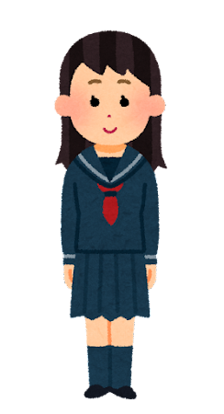
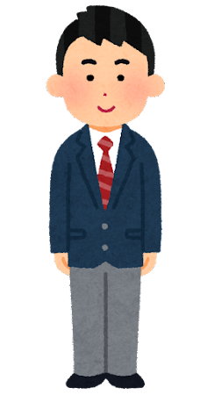
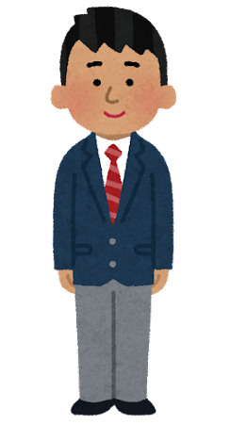
Please tell me your name.
+1
Please / me / tell / your name.
My name is Taki Tachibana.
+1

Slide 3
Please / me / your birthday / tell

Slide 4
a pencil / bring / Please / me

Slide 5
Please / me / show / a peace sign

Slide 6
Please / tell / your club activity / me

Slide 7
Please / draw / Anpanman / me

Slide 8
tell / me / Please / your favorite animal

Slide 9
Please / [ALT]’s state 出身の州/ tell / me

Slide 10
tell / Please / me / five prefectures 都道府県

Slide 11
Please / me / your favorite movie / tell

Slide 12
give / me / Please / a high five (ハイタッチ）

Slide 13
your favorite conbini / tell / me / Please

Slide 14
Please / me / your birthday / tell

Slide 15
Please / tell / your club activity / me

Slide 16
today’s weather / tell / Please / me

Slide 17
bring / character goods / me / Please

Slide 18
me / Please / tell / today’s lunch

Slide 19
tell / Please / me / three American cities

Slide 20
Doraemon / Please / draw / me

Slide 21
show / me / gyaru peace / Please

Slide 22
sing / me / Please / “Happy Birthday”

Slide 23
tell / me / your favorite ramen / Please

Slide 24
bring / your pencil case / Please / me

Slide 25
show / Please / me / your hands

Slide 26
Please / me / tell / Jugemu Jugemu

Slide 27
a pencil / bring / Please / me

Slide 28
give / me / Please / a high five (ハイタッチ）

Slide 29
your textbook / Please / bring / me

Slide 30
Please / a hand-heart / show / me

Slide 31
Please / me / draw / [JTE]-sensei

Slide 32
Please / me / your birthday / tell

