Slide 1
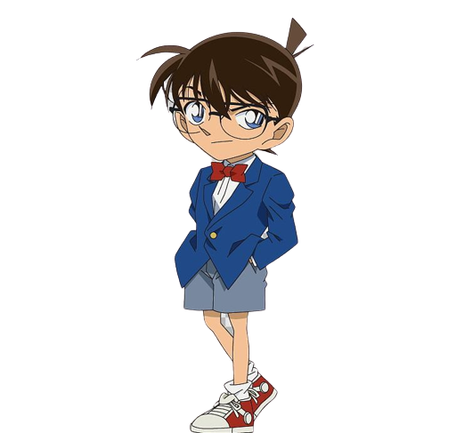
Code breaker
with Conan

Slide 2
Help me crack the code!
Rules
start

Slide 3
Rules
Find the hidden words in the random letters.
The word with the most letters wins.
You have to to use it in a sentence.

Slide 4
1 point for every letter
5 points for the sentence
No sentence = 0 points!

Slide 5
Example
m | s | e | w | a | t | r | u | p
m | s | e | r | n | l | c | d | o
Can you spot the hidden words?

Slide 6
Example
m | s | e | w | a | t | r | u | p
m | s | e | r | n | l | c | d | o
m | s | e | w | a | t | r | u | p
m | s | e | r | n | l | c | d | o
sports
6 points

Slide 7
Example
m | s | e | w | a | t | r | u | p
m | s | e | r | n | l | c | d | o
m | s | e | w | a | t | r | u | p
m | s | e | r | n | l | c | d | o
watermelons
11 points

Slide 8
I like to eat_____________ on the weekend.
5 points
watermelons
My favorite _______ are soccer and tennis.
sports
5 points

Slide 9
Remember: no sentence = 0 points!

Slide 10
You have 3 minutes

Slide 11
Are you ready?

Slide 12
choose a level
1
6
11
14
2
7
12
15
3
8
4
9
13
16
5
10

Slide 13
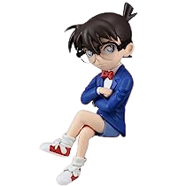
1
l | a | b | e | o | r | m | c | d
l | a | b | s | p | u | n | c | w

Slide 14
2
s | o | t | r | a | e | b | m | i
s | o | t | n | u | y | d | k | d

Slide 15
3
n | r | a | i | p | d | t | l | e | o
n | r | a | b | y | m | g | r | s | o

Slide 16
4
n | n | i | a | c | h | r | s
n | g | b | e | p | d | u | m

Slide 17
5
p | l | a | b | f | s | o | n | g | i
p | l | a | b | h | t | e | n | q | r

Slide 18
6
o | r | k | i | w | r | e | s
o | r | p | h | a | t | m | u

Slide 19
7
n | m | w | e | s | t | l | o | i
n | y | d | e | a | r | l | u | g

Slide 20
8
p | e | o | n | m | h | a | w | r
p | e | o | n | k | u | s | t | v

Slide 21
9
n | s | a | i | t | c | m | f | g
n | s | a | e | u | r | n | p | l

Slide 22
10
y | e | r | i | n | t | a | l
y | e | v | o | g | s | d | k

Slide 23
11
o | t | g | y | w | s | r
o | t | d | b | c | l | e

Slide 24
12
s | u | t | g | c | y | a
s | i | n | o | e | r | p

Slide 25
13
e | p | o | m | h | w | n | a
l | i | o | k | s | t | r | v

Slide 26
14
a | c | i | r | d | g
a | y | s | p | d | n

Slide 27
15
o | s | i | n | f | g
o | l | i | d | h | n

Slide 28
9
16
t | a | s | q | r | g
t | e | s | u | i | n

