Slide 1
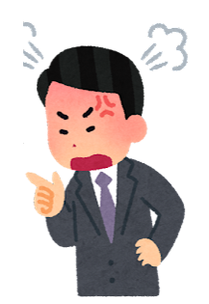
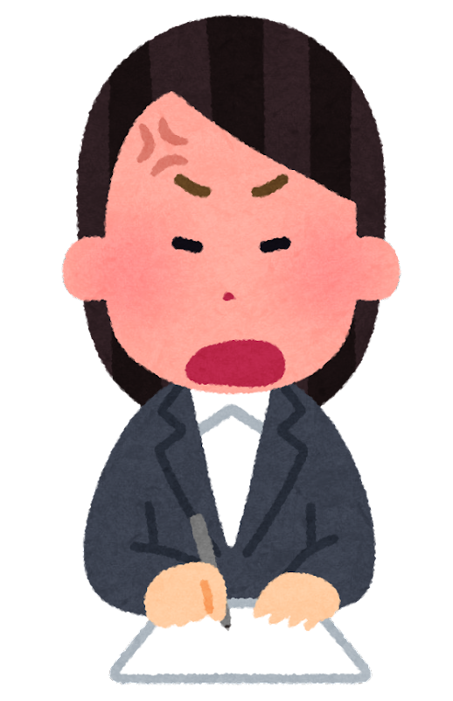
mean teacher
mean teacher
mean teacher
I’m afraid I can’t.
Not now.
No, I’m sorry.
No, I won’t.
I’m afraid I can’t.
Not now.
No, I’m sorry.
No, I won’t.
I’m afraid I can’t.
Not now.
No, I’m sorry.
No, I won’t.
mean teacher
mean teacher
mean teacher
I’m afraid I can’t.
Not now.
No, I’m sorry.
No, I won’t.
I’m afraid I can’t.
Not now.
No, I’m sorry.
No, I won’t.
I’m afraid I can’t.
Not now.
No, I’m sorry.
No, I won’t.
mean teacher
mean teacher
mean teacher
I’m afraid I can’t.
Not now.
No, I’m sorry.
No, I won’t.
I’m afraid I can’t.
Not now.
No, I’m sorry.
No, I won’t.
I’m afraid I can’t.
Not now.
No, I’m sorry.
No, I won’t.

Slide 2
mean teacher
mean teacher
mean teacher
I’m afraid I can’t.
Not now.
No, I’m sorry.
No, I won’t.
I’m afraid I can’t.
Not now.
No, I’m sorry.
No, I won’t.
I’m afraid I can’t.
Not now.
No, I’m sorry.
No, I won’t.
mean teacher
mean teacher
mean teacher
I’m afraid I can’t.
Not now.
No, I’m sorry.
No, I won’t.
I’m afraid I can’t.
Not now.
No, I’m sorry.
No, I won’t.
I’m afraid I can’t.
Not now.
No, I’m sorry.
No, I won’t.
mean teacher
mean teacher
mean teacher
I’m afraid I can’t.
Not now.
No, I’m sorry.
No, I won’t.
I’m afraid I can’t.
Not now.
No, I’m sorry.
No, I won’t.
I’m afraid I can’t.
Not now.
No, I’m sorry.
No, I won’t.

Slide 3
mean teacher
mean teacher
mean teacher
I’m afraid I can’t.
Not now.
No, I’m sorry.
No, I won’t.
I’m afraid I can’t.
Not now.
No, I’m sorry.
No, I won’t.
I’m afraid I can’t.
Not now.
No, I’m sorry.
No, I won’t.
mean teacher
mean teacher
mean teacher
I’m afraid I can’t.
Not now.
No, I’m sorry.
No, I won’t.
I’m afraid I can’t.
Not now.
No, I’m sorry.
No, I won’t.
I’m afraid I can’t.
Not now.
No, I’m sorry.
No, I won’t.
mean teacher
mean teacher
mean teacher
I’m afraid I can’t.
Not now.
No, I’m sorry.
No, I won’t.
I’m afraid I can’t.
Not now.
No, I’m sorry.
No, I won’t.
I’m afraid I can’t.
Not now.
No, I’m sorry.
No, I won’t.

Slide 4
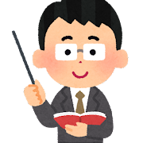
nice teacher
nice teacher
nice teacher
Yes, of course.
Okay, sure.
No problem.
Yes, I can.
Yes, of course.
Okay, sure.
No problem.
Yes, I can.
Yes, of course.
Okay, sure.
No problem.
Yes, I can.
nice teacher
nice teacher
nice teacher
Yes, of course.
Okay, sure.
No problem.
Yes, I can.
Yes, of course.
Okay, sure.
No problem.
Yes, I can.
Yes, of course.
Okay, sure.
No problem.
Yes, I can.
nice teacher
nice teacher
nice teacher
Yes, of course.
Okay, sure.
No problem.
Yes, I can.
Yes, of course.
Okay, sure.
No problem.
Yes, I can.
Yes, of course.
Okay, sure.
No problem.
Yes, I can.

Slide 5
nice teacher
nice teacher
nice teacher
Yes, of course.
Okay, sure.
No problem.
Yes, I can.
Yes, of course.
Okay, sure.
No problem.
Yes, I can.
Yes, of course.
Okay, sure.
No problem.
Yes, I can.
nice teacher
nice teacher
nice teacher
Yes, of course.
Okay, sure.
No problem.
Yes, I can.
Yes, of course.
Okay, sure.
No problem.
Yes, I can.
Yes, of course.
Okay, sure.
No problem.
Yes, I can.
nice teacher
nice teacher
nice teacher
Yes, of course.
Okay, sure.
No problem.
Yes, I can.
Yes, of course.
Okay, sure.
No problem.
Yes, I can.
Yes, of course.
Okay, sure.
No problem.
Yes, I can.

Slide 6
nice teacher
nice teacher
nice teacher
Yes, of course.
Okay, sure.
No problem.
Yes, I can.
Yes, of course.
Okay, sure.
No problem.
Yes, I can.
Yes, of course.
Okay, sure.
No problem.
Yes, I can.
nice teacher
nice teacher
nice teacher
Yes, of course.
Okay, sure.
No problem.
Yes, I can.
Yes, of course.
Okay, sure.
No problem.
Yes, I can.
Yes, of course.
Okay, sure.
No problem.
Yes, I can.
nice teacher
nice teacher
nice teacher
Yes, of course.
Okay, sure.
No problem.
Yes, I can.
Yes, of course.
Okay, sure.
No problem.
Yes, I can.
Yes, of course.
Okay, sure.
No problem.
Yes, I can.

