Slide 1
How many do you have?
PART TWO

Slide 2
NUMBERS
1
2
3
4
5
6
7
8
9
10
11
12
13
14
15
16
17
18
19
20

Slide 3
ONE

Slide 4
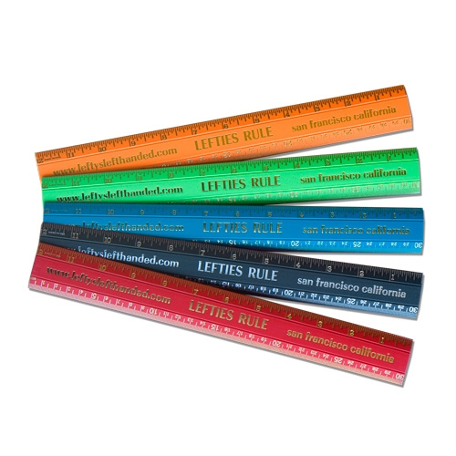
How many do you have?
I have 5 rulers.
ANSWER

Slide 5
TWO

Slide 6
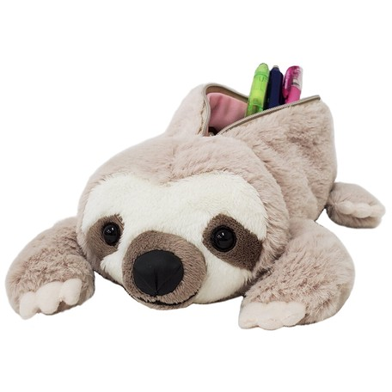
How many do you have?
I have 1 pencil case.
ANSWER

Slide 7
LAST

Slide 8
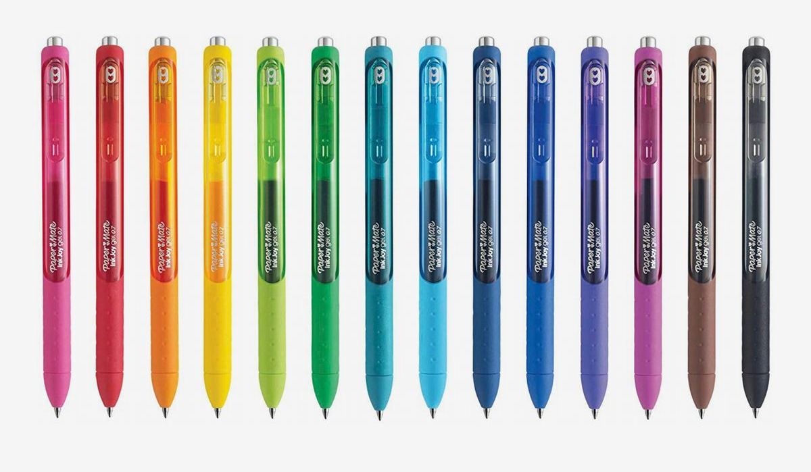
How many do you have?
I have 14 pens.
ANSWER

Slide 9
THE END

