Slide 1
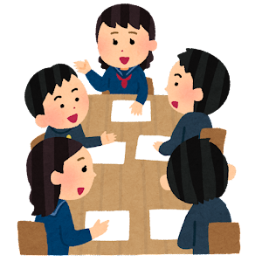
Game time! Heads up!
The rules:
1. Get into groups of four or five.

Slide 2
Game time! Heads up!
The rules:
2. One person will pick up one card. DO NOT look at it!

Slide 3
Game time! Heads up!
The rules:
3. Hold up your card to your forehead with your word facing your groupmates.

Slide 4
Game time! Heads up!
The rules:
4. Your groupmates will help guess their own word with hints or descriptions, but don't tell them the word! PLEASE USE ENGLISH!
It goes meow!
It is a pet!

Slide 5
Game time! Heads up!
The rules:
5. Once your groupmate gets it correct, go to the next person!

Slide 6
Game time! Heads up!
The rules:
5. Once your groupmate gets it correct, go to the next person!

Slide 7
Game time! Heads up!
The rules:
5. Once your groupmate gets it correct, go to the next person!

Slide 8
Game time! Heads up!
The rules:
5. Once your groupmate gets it correct, go to the next person!

Slide 9
Game time! Heads up!
The rules:
5. Once your groupmate gets it correct, go to the next person!

Slide 10
Game time! Heads up!
The rules:
6. If no one in your group knows the word, then pick up a different word from the pile.

Slide 11
1. Get into groups of four or five.
1. 4 人または 5 人のグループに分かれます。
2. One person will pick up one card. DO NOT look at it!
2. 1人がカードを1枚受け取ります。 見ないでください！
3. Hold up your card to your forehead with your word facing your groupmates.
3. カードを額にかざし、単語をグループメイトに向けます。
4. Your groupmates will help guess their own word with hints or descriptions, but don't tell them the word! PLEASE USE ENGLISH!
4. グループの友達は、ヒントや説明を使って自分の単語を推測するのを手伝ってくれますが、単語を教えないでください。 英語を使ってください!
5. Once your groupmate gets it correct, go to the next person!
5. グループメイトが正解したら、次の人に進みます。
6. If no one in your group knows the word, then pick up a different word from the pile.
6. グループ内でその単語を知っている人がいない場合は、山から別の単語を選びます。

