Slide 1
I LIKE __.
I DON’T LIKE __.

Slide 2
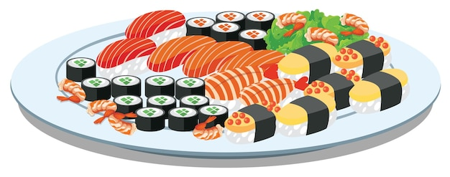
EXAMPLE:
I LIKE SUSHI.

Slide 3
I LIKE PURPLE.

Slide 4
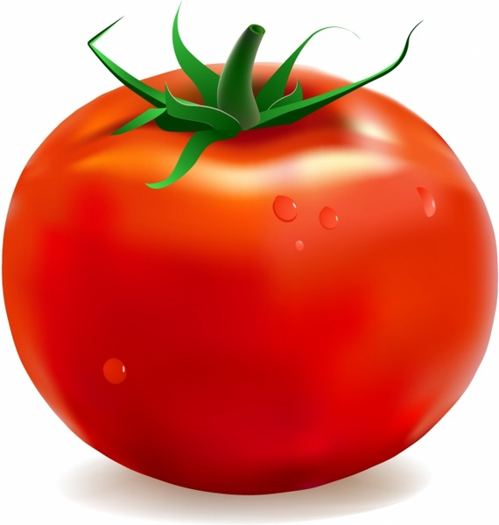
I DON’T LIKE TOMATO.

Slide 5
I LIKE MARIO.

Slide 6
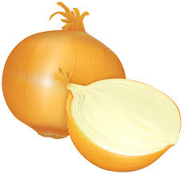
I DON’T LIKE ONION.

Slide 7
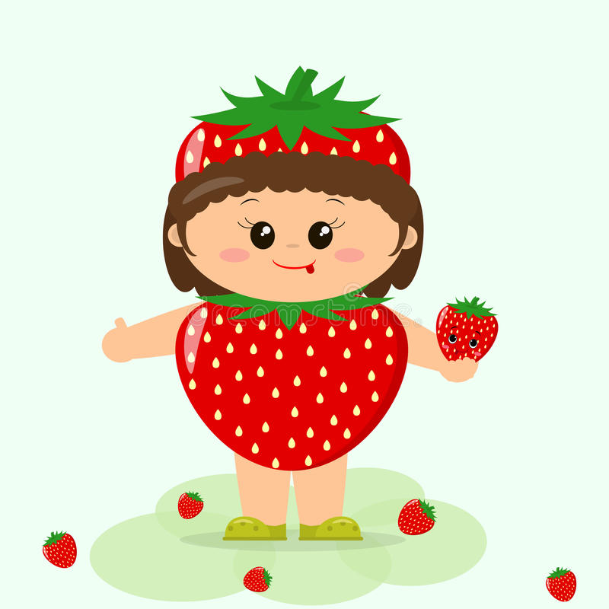
I LIKE STRAWBERRY.

Slide 8
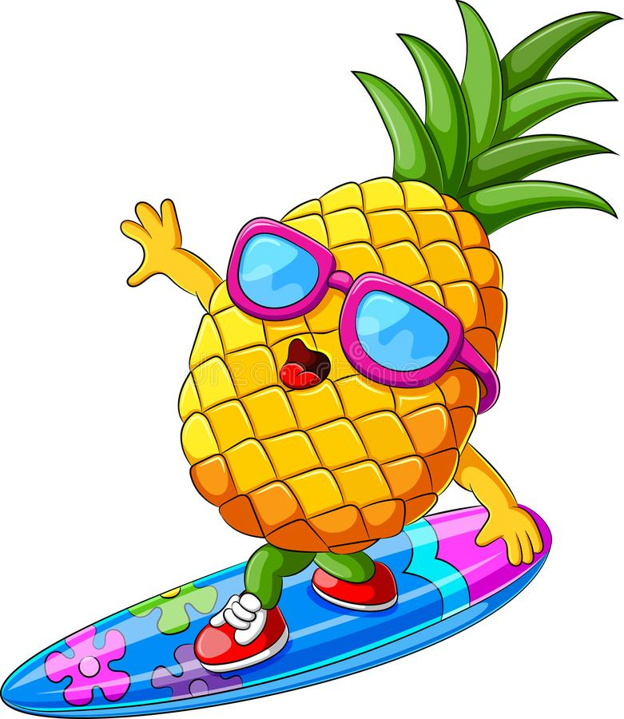
I DON’T LIKE PINEAPPLE.

Slide 9
I LIKE FISH.

Slide 10
I LIKE ORANGE

Slide 11
I DON’T LIKE GREEN.

Slide 12
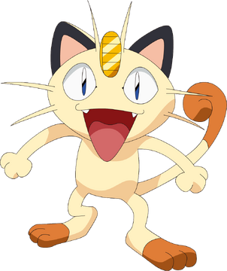
I DON’T LIKE CAT.

