Slide 2
How it works
Objective: Practice reading and pronouncing newly introduced vocab for points
Before you play, place the vocabulary into the word boxes on the game slide.
Go over the vocabulary words with your students before hand
Show the students the game board and have them say a word. With each word they select, they will get points
After finishing one round, count the total points points to see who the winner is. If it is a larger class, make it team focused and if it is a small class make it individual points. Play as many rounds as time allows with the different boards provided. Each has different pint layouts
P.S. The point worth is rather obvious, but the robot is not. It is worth 0 points. The art is so beautiful it would break my heart to slap a font on it. Now you know. Have fun ☺

Slide 3
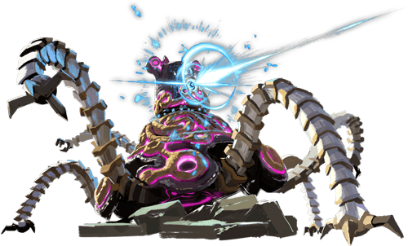
Apple
Peach
Banana
Cherry
Melon
Grapes
Pineapple
Strawberry
Potato
Corn
Carrot
Onion
Broccoli
Cabbage
Mushroom
Cucumber

Slide 4
Blank
Blank
Blank
Blank
Blank
Blank
Blank
Blank
Blank
Blank
Blank
Blank
Blank
Blank
Blank
Blank

Slide 5
