Slide 1
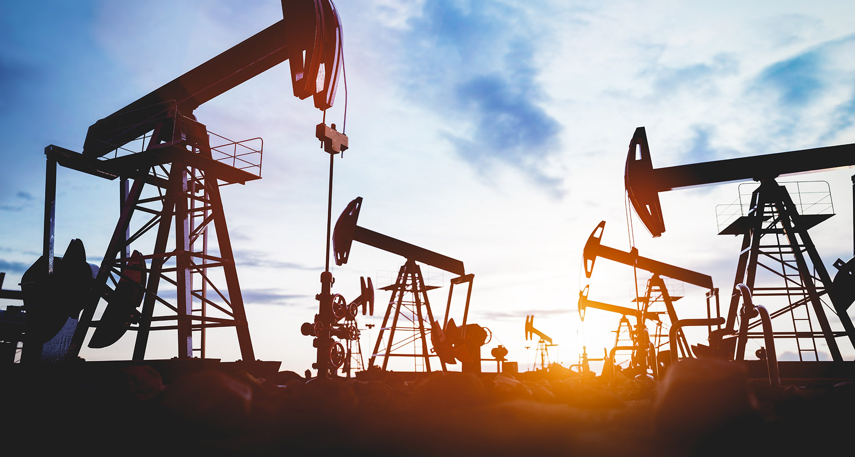
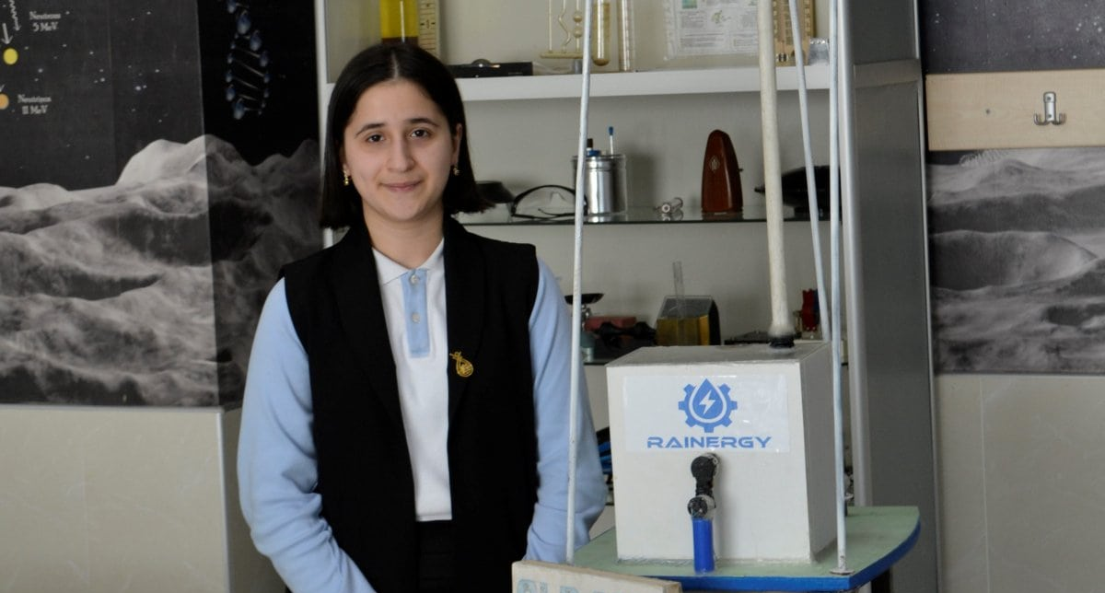
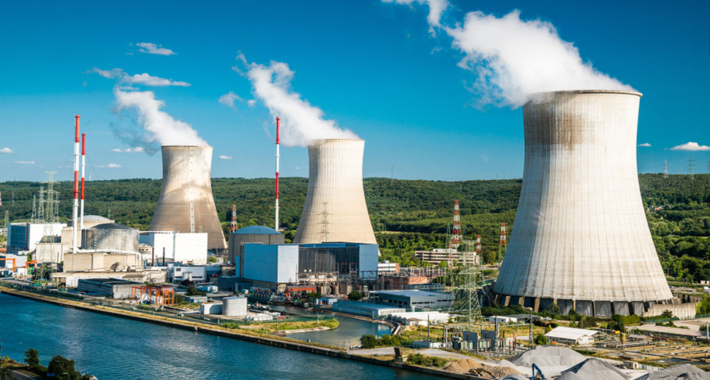
Power Your Future!

Slide 2
Q1 When may we run out of fossil fuels?
150 years
10 years
80 years
100 years

Slide 3
Q2 What is NOT a problem from fossil fuels?
Carbon Dioxide (CO₂)
Plastic waste
Bad health
Global warming

Slide 4
Q3 True or False: We depend on electricity for most of our daily activities.
True
False

Slide 5
Q4 What is an example of renewable energy?
Oil
Steam
Natural gas
Coal

Slide 6
Q5 How much energy does Iceland get from natural heat in the ground?
One quarter
One half
Forty percent
Two quarters

Slide 7
Q6 Which sentence is false?
Water is a renewable resource.
There are no problems with using water to make electricity.
Dams can damage the environment.

Slide 8
Q7 True or false: Japan does not use nuclear power.
True
False

Slide 9
Q8 What are energy sources that are not renewable called?
Dead resources
Black fuels
Earth fuels
Fossil fuels

Slide 10
Q9 True or false: Denmark gets 40% of its electricity from water power.
True
False

Slide 11
Q10 True or false: Japan uses rivers to produce electricity.
True
False

Slide 12
Q11 How old was Reyhan Jamalova when she invented her device?
Sixteen
Nineteen
Fifteen
Thirteen

Slide 13
Q12 What does Reyhan Jamalova’s device use?
Steam
7 Liters of rainwater
10 Liters of rainwater
Nuclear power

Slide 14
Q13 True or false: Reyhan Jamalova’s device is expensive.
True
False

Slide 15
Q14 How long can Reyhan Jamalova’s device power 22 LED lamps for?
50 seconds
10 minutes
30 seconds
An hour

Slide 16
Q15 True or false: You can help make a sustainable energy future.
True
False

