Slide 2
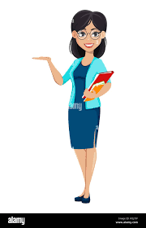
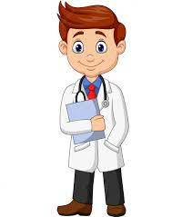
What do you want to be in the future?

Slide 3
New WORds

Slide 4
learn
progress
lives
disappear
appear
should
hear
change
AI (Artificial Intelligence)

Slide 5
Infinitives to ~

Slide 6
Practice

Slide 7
I went to school to study well.

Slide 8
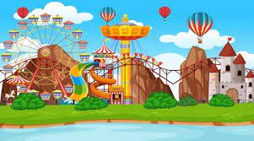
I went to the themed park
to ride the attractions.

Slide 9
He is glad to see my test score.

Slide 10
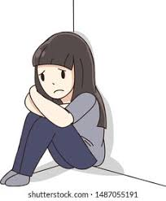
She is sad to hear the bad news.

Slide 11
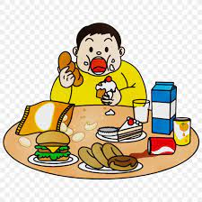
He bought a lot of
snacks to eat .

Slide 12
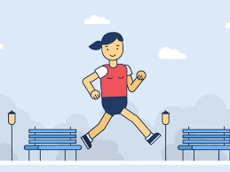
She went to the park
to run.

Slide 13
She went to the
library to read books.

Slide 14
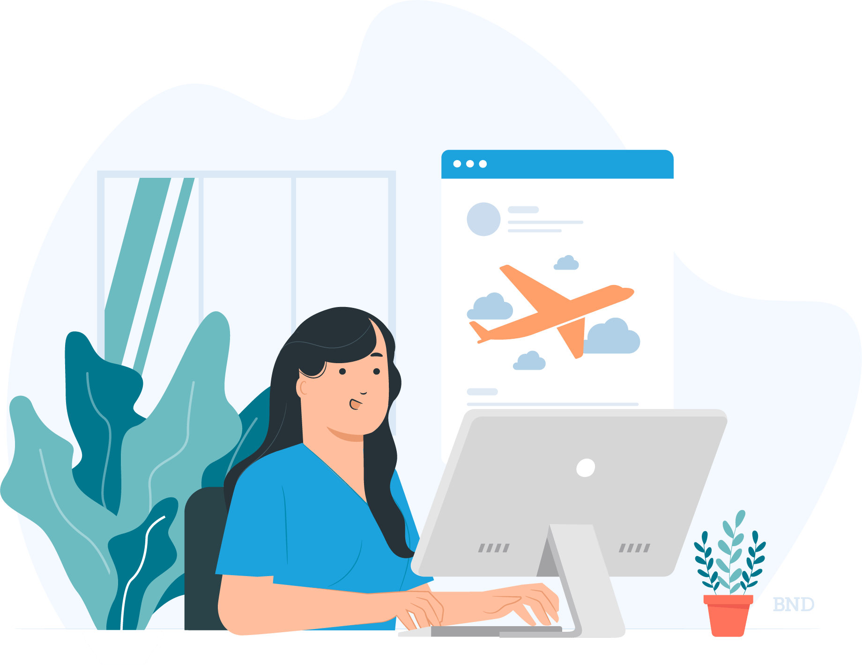
She works a lot to travel
around the world.

Slide 15
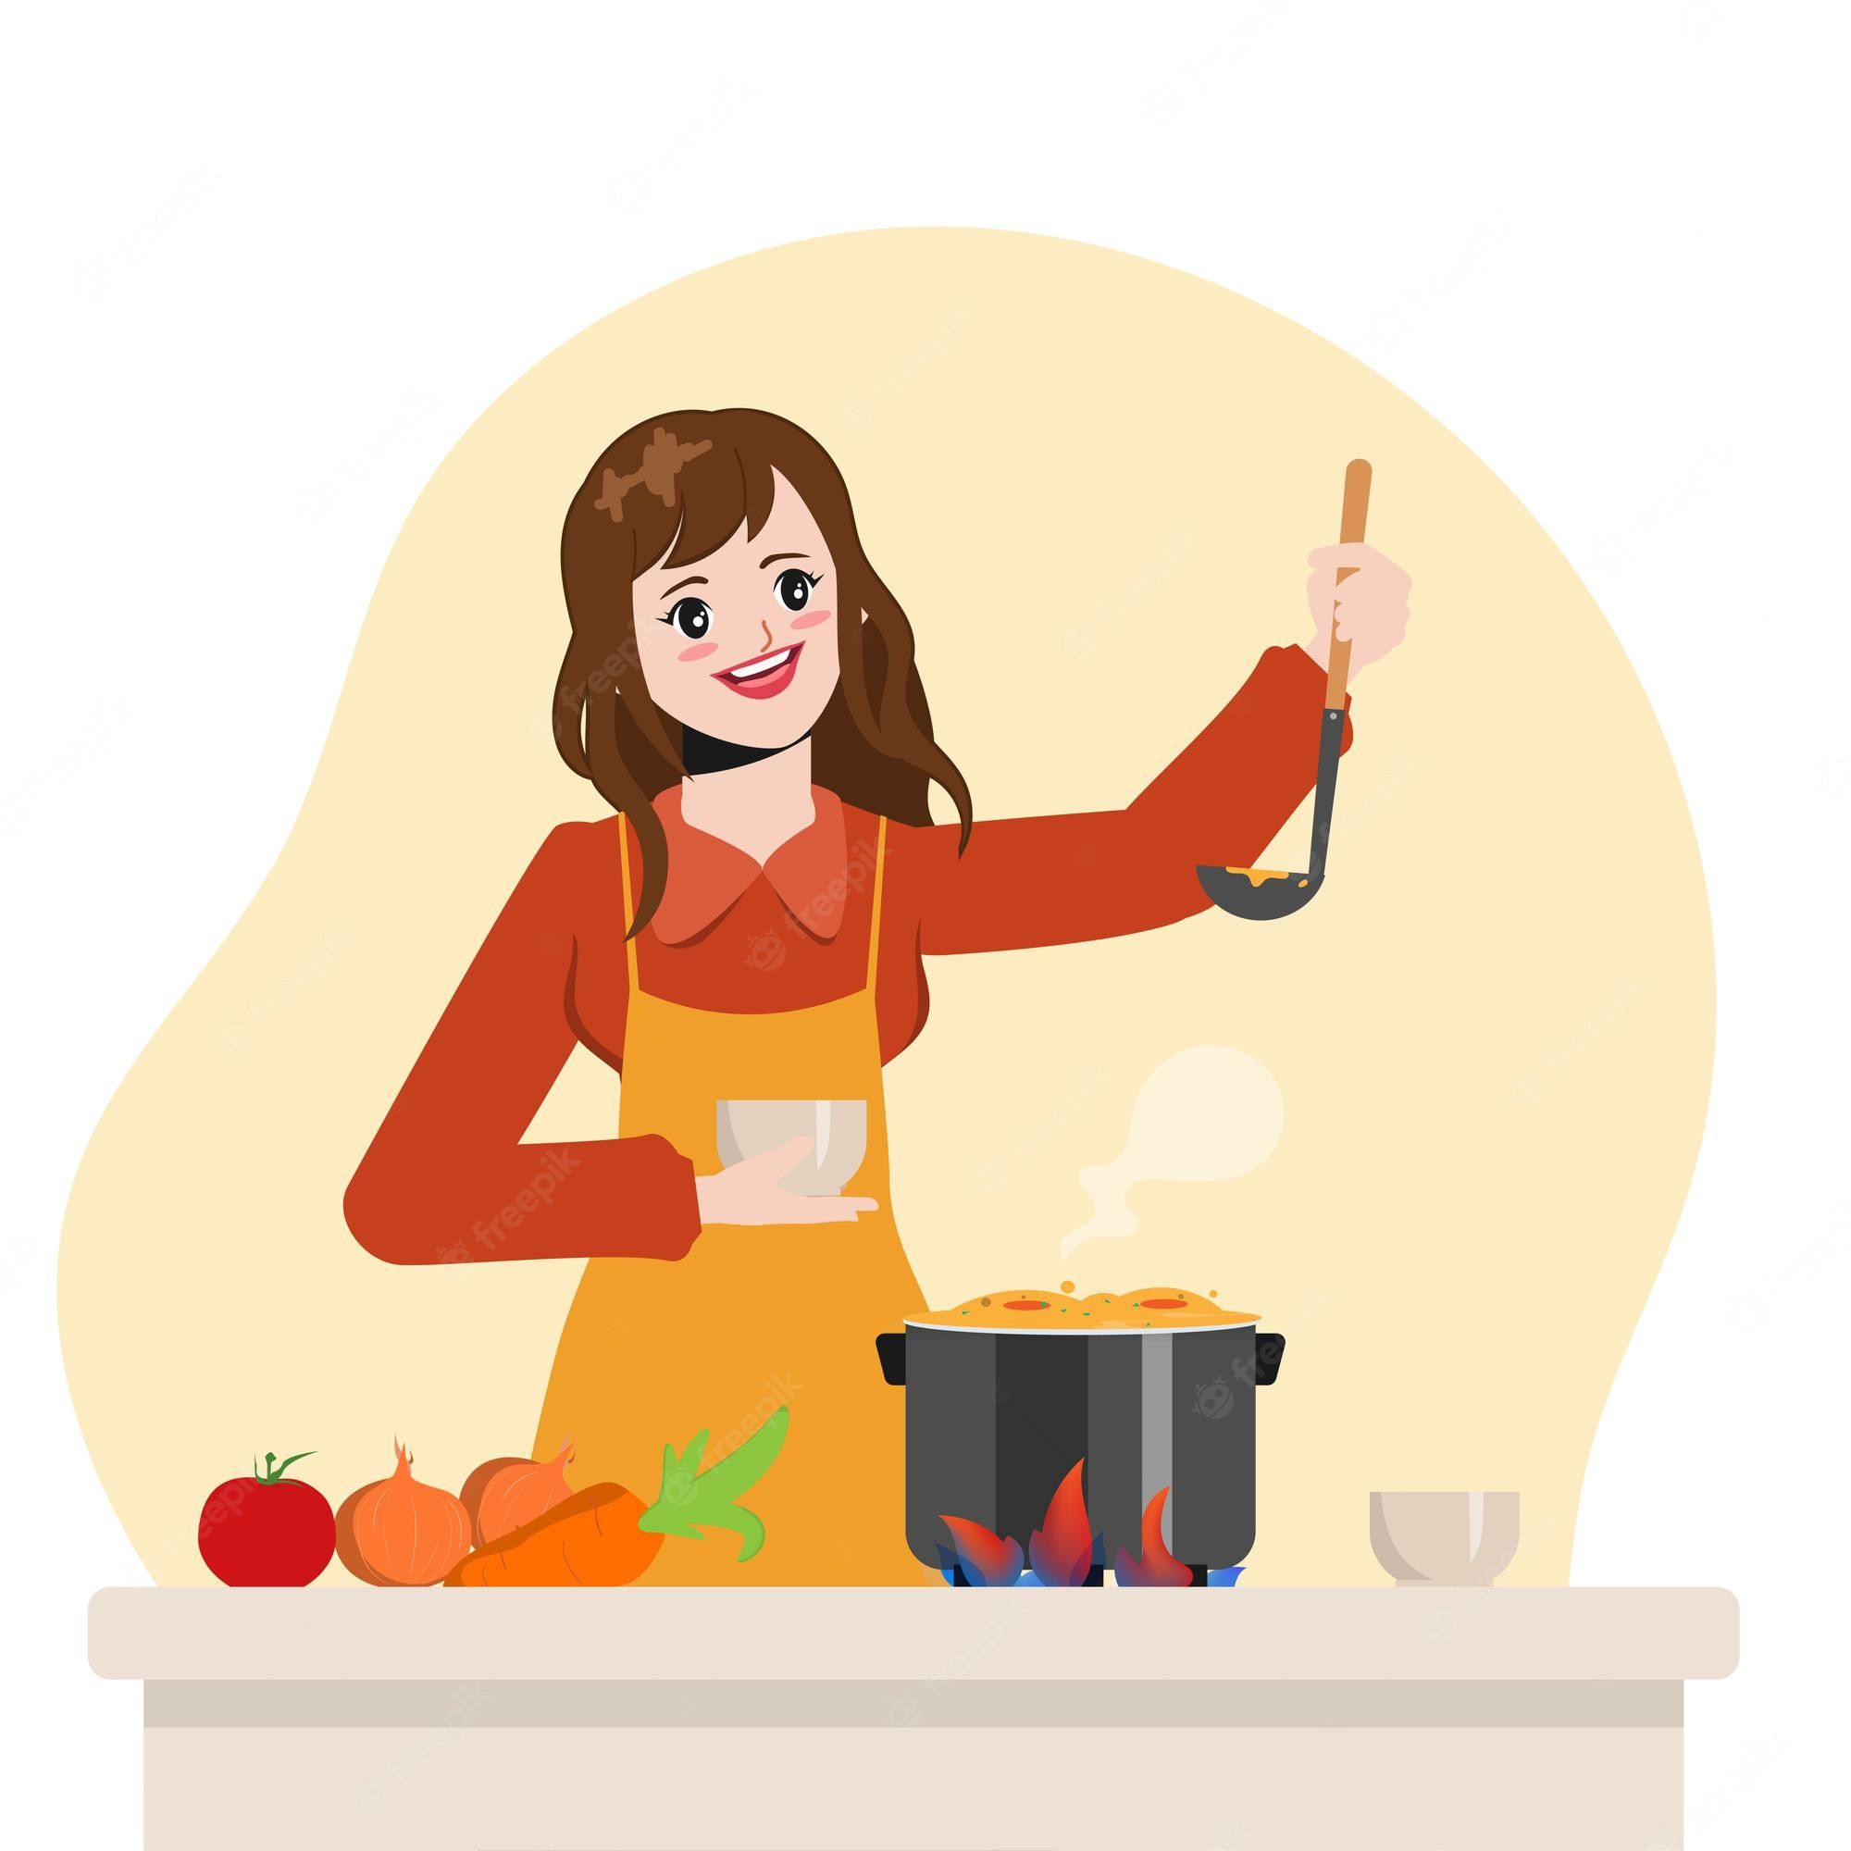
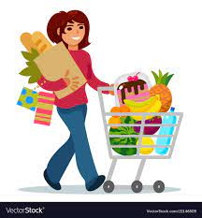
She bought groceries
to cook for dinner.

Slide 16
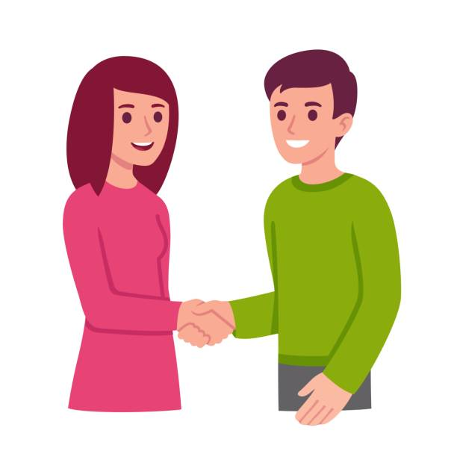
She is happy to meet him.

Slide 17
Speaking practice part 1

Slide 18
Writing practice part 2

