Slide 1
Were you... Was it...

Slide 2
yesterday
What does it mean?

Slide 3
昨日
What does it mean?

Slide 4
last night
What does it mean?

Slide 5
昨日の夜；昨夜
What does it mean?

Slide 6
this morning
What does it mean?

Slide 7
今朝
What does it mean?

Slide 8
on Sunday
What does it mean?

Slide 9
日曜日に
What does it mean?

Slide 10
last week
What does it mean?

Slide 11
先週
What does it mean?

Slide 12
last weekend
What does it mean?

Slide 13
先週末
What does it mean?

Slide 14
last month
What does it mean?

Slide 15
先月
What does it mean?

Slide 16
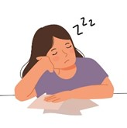
Were you sleepy yesterday?
What does it mean?
答え方は？
Yes, I was. / No, I wasn’t.

Slide 17
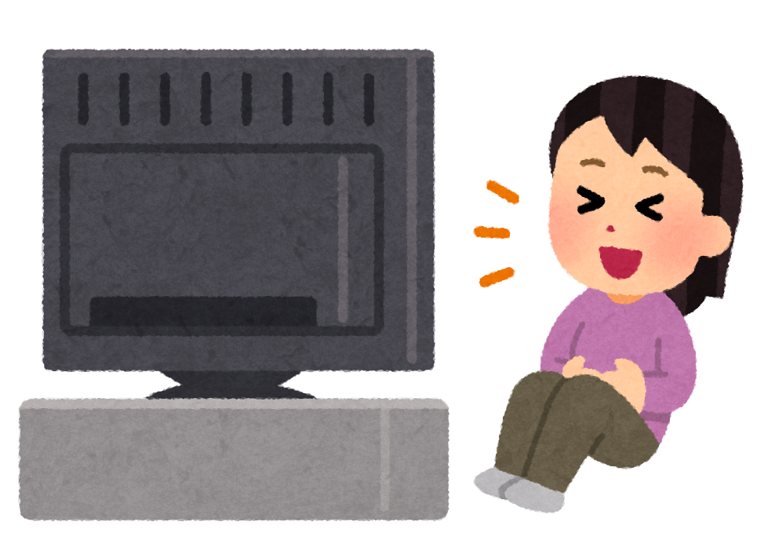
Were you watching TV last night?
What does it mean?
答え方は？
Yes, I was. / No, I wasn’t.

Slide 18
Was it sunny yesterday?
What does it mean?
答え方は？
Yes, it was. / No, it wasn’t.

Slide 19
Was your room messy last weekend?
What does it mean?
答え方は？
Yes, it was. / No, it wasn’t.

Slide 20
Ask the teacher.
What does it mean?
先生に聞いて

Slide 21
Ask a friend.
What does it mean?
友達に聞いて

Slide 22
Please take a yellow card AND a pink card.

Slide 23
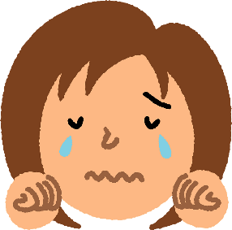
Please take a yellow card AND a pink card.
Were you sad...
yesterday?
example

