Slide 1
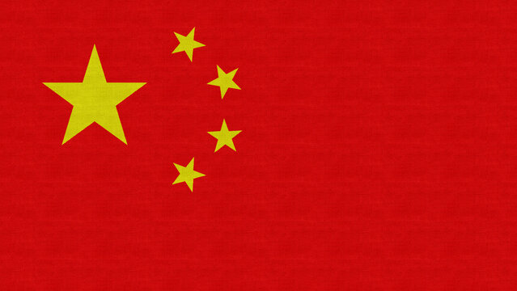
START/
GOAL
Finland
China
Germany
Japan
Australia
Greetings
Around the world
India
Mexico
Portugal
Korea
Saudi Arabia
America
Kenya
Spain
France

