Slide 1
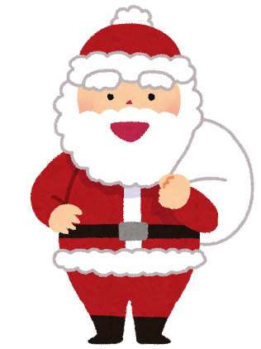
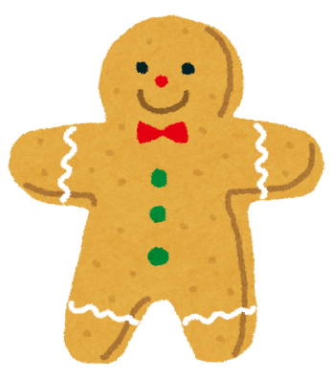
Santa
Santa
Santa
Santa
Santa
Cookie
Cookie
Cookie
Cookie
Cookie

Slide 2
Present
Present
Present
Present
Present
Candy
Candy
Candy
Candy
Candy

Slide 3
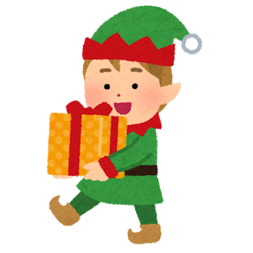
Santa
Santa
Present
Present
Elf
Cookie
Cookie
Candy
Candy
Elf

Slide 4
Elf
Elf
Elf
Elf
Elf
Grinch
Grinch
Grinch
Grinch
Grinch

