Slide 1
Quiz Time!
Are you…? / Do you…?

Slide 2
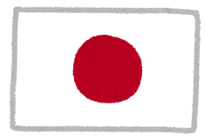
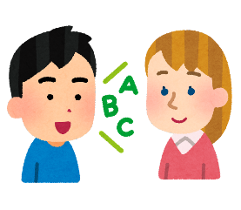
What’s the difference?
Are you from Japan?
Do you speak English?

Slide 3
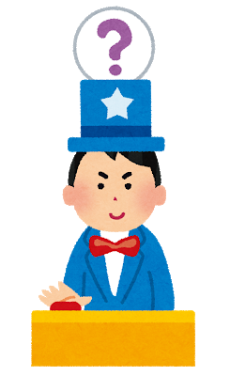
QUIZ
TIME

Slide 4
ROUND ONE

Slide 5
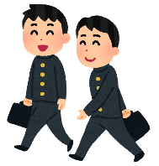
Are you…? / Do you…?
Doing judo makes me tired
__________ a boy?
Are you a boy?

Slide 6
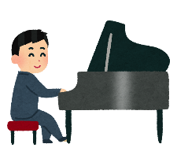
Are you…? / Do you…?
Doing judo makes me tired
__________ play piano?
Do you play piano?

Slide 7
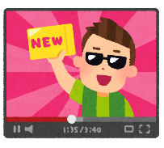
Are you…? / Do you…?
Do you want to be a YouTuber?
Doing judo makes me tired
__________ want to be a YouTuber?

Slide 8
Are you…? / Do you…?
Doing judo makes me tired
__________ happy now?
Are you happy now?

Slide 9
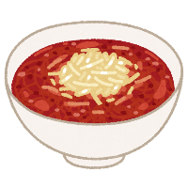
Are you…? / Do you…?
Do you like spicy food?
Doing judo makes me tired
__________ like spicy food?

Slide 10
LEVEL UP!

Slide 11
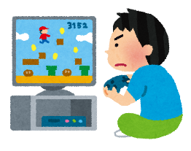
Are you…? / Do you…?
Doing judo makes me tired
__________ play games everyday?
Do you play games everyday?
Do you play games everyday?

Slide 12
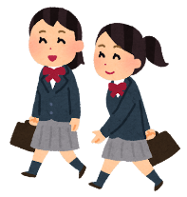
Are you…? / Do you…?
Doing judo makes me tired
__________ a girl?
Are you a girl?

Slide 13
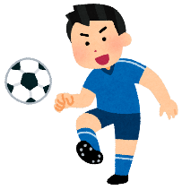
Are you…? / Do you…?
Doing judo makes me tired
__________ like soccer?
Do you like soccer?
Do you like soccer?

Slide 14
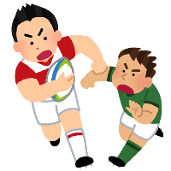
Are you…? / Do you…?
Doing judo makes me tired
__________ a rugby fan?
Are you a rugby fan?

Slide 15
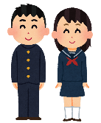
Are you…? / Do you…?
_______ a junior high school student?
Are you a junior high school student?
Doing judo makes me tired

Slide 16
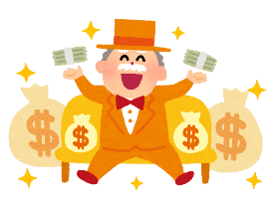
Are you…? / Do you…?
Doing judo makes me tired
__________ want lots of money?
Do you want lots of money?
Do you want lots of money?

Slide 17
Are you…? / Do you…?
Doing judo makes me tired
__________ from America?
Are you from America?

Slide 18
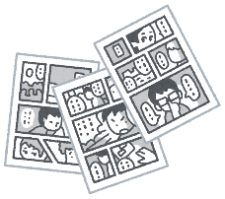
Are you…? / Do you…?
Doing judo makes me tired
__________ read manga?
Do you read manga?
Do you read manga?

Slide 19
FINISH!

