Slide 1
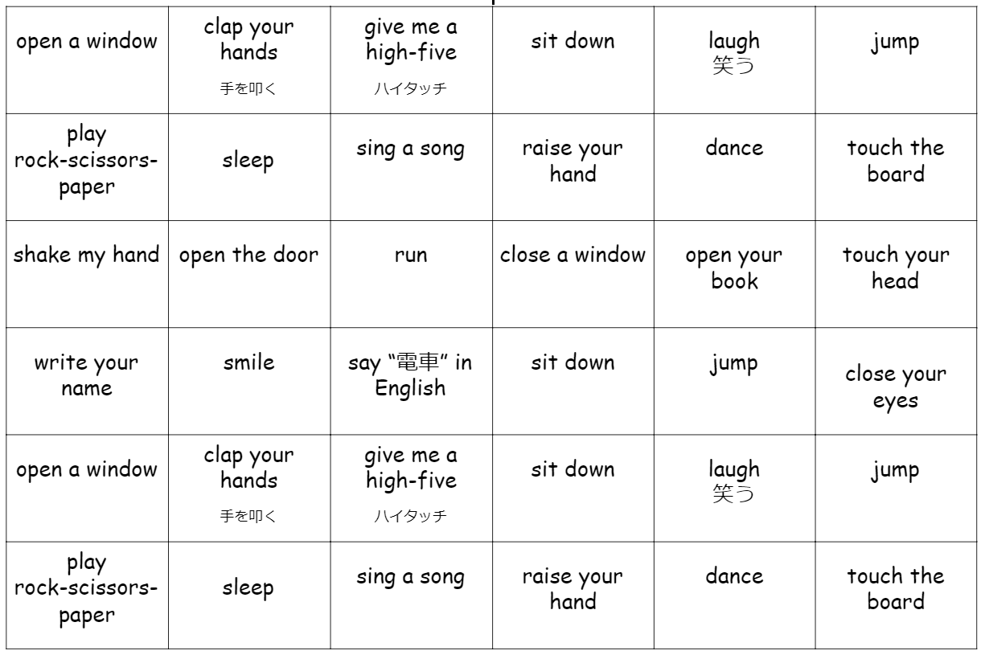

Slide 2
2

Slide 3
7
1
2
3
4
5
6
1
3
2
3
2
2
1
1
3
4
3
5
7
8
9
10
11
12
5
2
5
2
1
5
1
5
2
3
3
3
13
14
15
16
17
18
1: iiiii
ii
2: iiiii
iiii
3: iiiii
iiii
4: iiii
5. iiii
1
1
1
1
2
4
4
4
3
4
3
3
19
20
21
22
23
24
1
1
1
3
3
2
1
4
4
2
2
25
26
27
28
29
30
3
3
2
1
2
2
4
4
1
2
3
5
31
32
33
34
35
36
1
3
5
5
2
5
1
1
3
2
3
2

Slide 4
7
1
2
3
4
5
6
1
3
2
3
2
2
1
1
3
4
3
5
7
8
9
10
11
12
5
2
5
2
1
5
1
5
2
3
3
3
13
14
15
16
17
18
1: iiiii
ii
2: iiiii
iiii
3: iiiii
iiii
4: iiii
5. iiii
1
1
1
1
2
4
4
4
3
4
3
3
19
20
21
22
23
24
1
1
1
3
3
2
1
4
4
2
2
25
26
27
28
29
30
3
3
2
1
2
2
4
4
1
2
3
5
31
32
33
34
35
36
1
3
5
5
2
5
1
1
3
2
3
2

