Slide 1
I like... I don’t like...

Slide 2
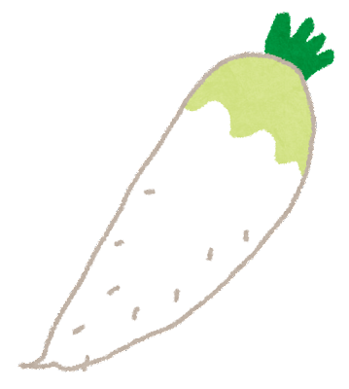
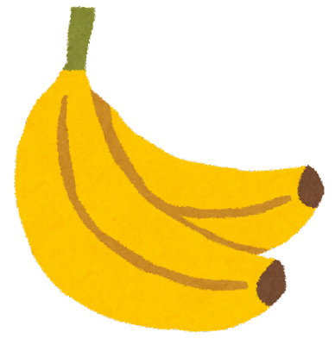
I like...
I don’t like...

Slide 3
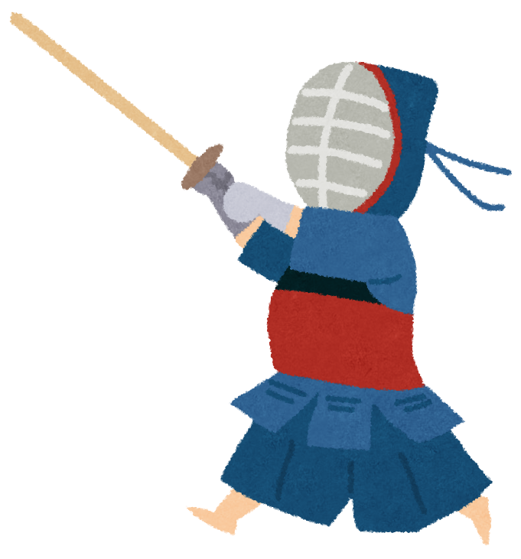
I like...
I don’t like...

Slide 4
I like...
I don’t like...

Slide 5
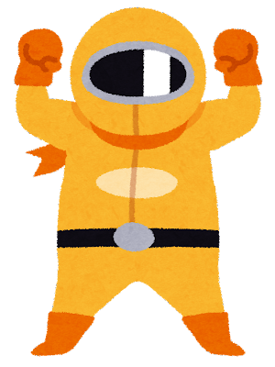
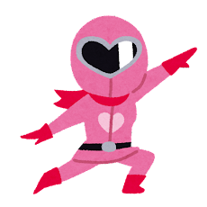
Hello, I’m _______. I like _______.
What (food / sport / color) do you like?
I’m _______. I like_______.
Thank you!!

