Slide 1
Flash Art
There is~

Slide 2
There is a sky at the top
There is a mountain behind the sea.
There are clouds above the sea.
There is a tree on the right side.
There is the sea in the middle.
There is a crab on top of the rock.
There is a beach at the bottom.

Slide 3
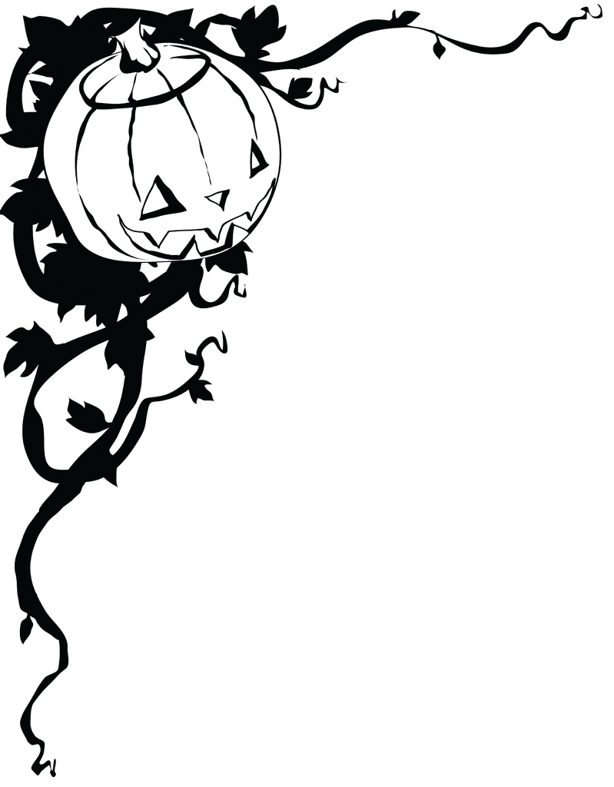
Let’s draw a Halloween picture!

Slide 4
There are many pumpkins with faces at the bottom.

Slide 5
There are scary trees _______ the ________.

Slide 6
There are many _____ and _____ birds above the trees.

Slide 7
There is a moon __ the _____ side.

Slide 8
There is a _____ in ___ ______.

Slide 9
FINISHED!

