Slide 1
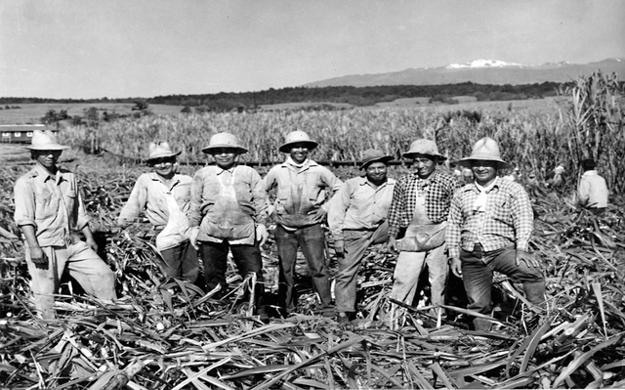
Hawaii Pidgin vs American English

Slide 2
What is Hawaii Pidgin?
Hawaii Pidgin is a creole language spoken in Hawaii.
A creole language is a language made from mixing other languages together.
A creole language is a hybrid language.
In Haiti, Africa, people speak Haitian Creole. Haitian Creole is a mix of French and African languages.
Jamaican creole is a mix of English, Spanish, West African, German, and Portuguese languages.

Slide 3
Activity #1: Dictation
Listen to this speech about the history of Hawaii Pidgin and fill in the blanks on your worksheet.
Then, pair up! And read the speech to each other.

Slide 4
The History of Hawaii Pidgin (Hawaii Creole English)
In 1835, the first sugarcane plantation 1. started in Hawaii. 2. People from all over the world came to Hawaii to 3. work on the farms. For example, people from Japan, China, Portugal, Russia, Spain, and the Philippines moved to Hawaii to work.
Most people did not 4. speak English. They could only speak their native 5. language.
Therefore, everyone on the sugarcane farm needed a common language that everyone could 6. understand.

Slide 5
The History of Hawaii Pidgin
The 7. children of these immigrants were born in Hawaii.
They learned their parent’s native language, English used in Hawaiian schools, and the Hawaiian language. These children 8. created a 9. new language, influenced by all of the 10. different languages used in Hawaii.
By 1920, most people in Hawaii spoke pidgin.

Slide 6
Examples of Pidgin Used in Hawaii
Hawaii Pidgin | Meaning | Origin Language
Tako | Octopus | Japanese
Shibai | A lie/ liar A hypocrite | Japanese
Howzit | “How are you?” | English
Hale | Home | Hawaiian
Hanabata | Runny nose | Japanese and English
Kapu | Forbidden Bad | Hawaiian
Kaukau | Come Eat | Chinese

Slide 7
Vocabulary
Hawaii Pidgin | English
Get | Have There is/ are…
Choke | Many/ Much/ A lot
Try | Please… This is a request

Slide 8
Activity #2/ Part 1: Using the vocabulary, change these sentences into proper English.
You get one pen? (Hint: Get means have in pidgin)
Do you have a pen?
Get choke mango this year. (Hint: Choke means many/ a lot)
There are a lot of/ many mango this year.
Try call her (Hint: Try is a request. It means please)
Please call her.

Slide 9
Activity #2/ Part 2: Write your own Hawaiian Pidgin and English translations using the vocabulary words.

Slide 10
Grammar
Hawaii Pidgin | English
Past-tense Wen I wen sleep good last night | Past-tense (Verb-ed/ or verb-t) I slept well last night.
Past-tense Negation Neva I neva eat yet. | Did/ Have + n’t + verb I didn’t eat yet.
Verb stay I stay using um | Am/ Is/ Are Implies a continuous state I am using it.

Slide 11
Activity #3:
Using the grammar table, create one Hawaii pidgin sentence and an English translation.

Slide 12
If can, can. If no can, no can.
If I can do it, I will do it OR
If you can do it, please do it.
2. If I can’t do it, I won’t do it OR
If you can’t do it, you can’t do it (It’s fine if you can’t do it).

Slide 13
Pronunciation
Hawaii Pidgin | English
Dis/ Das Das how we do um | This/ That’s That’s how we do it
Dah Pass me dah pencil. | The Please pass me the pencil.
Tink Wat you tink? | Think What do you think?

Slide 14
Hawaii Pidgin Pronunciation
1. Th sounds either drop the h (think > tink) or are pronounced as a d (that > dat).
2. R, when preceded by a vowel, is dropped (more better > mo’ bettah)
3. Likewise, L sounds at the end of words are pronounced like o (people > peepo)

Slide 15
Activity #4: List three ways pros and cons of pidgin
Pros | Cons
Ex. It is easy to understand. | Ex. There are too many languages.

Slide 16
Speaking Activity
Pair up!
With your partner, please talk.
Is Hawaii Pidgin a real language?

