Slide 1
Adapted By Robert Rosehart
Whose hat is this?
It’s Mario’s hat.

Slide 2
Whose flower is this?
It’s Kitty’s flower.

Slide 3
Whose mouth is this?
It’s Doraemon’s mouth.

Slide 4
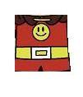
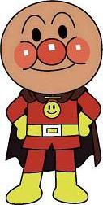
Whose suit is this?
It’s Anpanman’s suit.

Slide 5
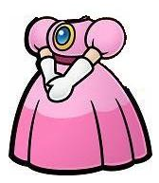
Whose dress is this?
It’s Peach’s dress.

Slide 6
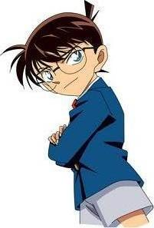
Whose eye is this?
It’s Konan’s eye.

Slide 7
Whose hat is this?
It’s Luigi’s hat.

Slide 8
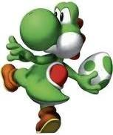
Whose nose is this?
It’s Yoshi’s nose.

Slide 9
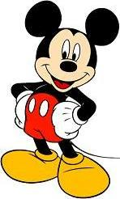
Whose ear is this?
It’s Mickey’s ear.

Slide 10
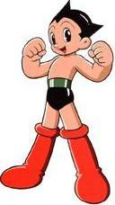
Whose boot is this?
It’s Atom’s boot.

Slide 11
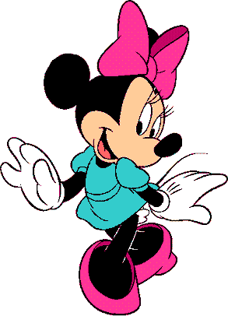
Whose ribbon is this?
It’s Minnie’s ribbon.

Slide 12
Whose bow is this?
It’s Maruko’s bow.

Slide 13
And finally…

Slide 14
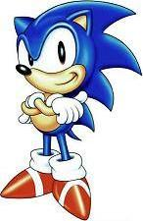
Whose shoe is this?
It’s Sonic’s shoe.

Slide 15
Next

Slide 16
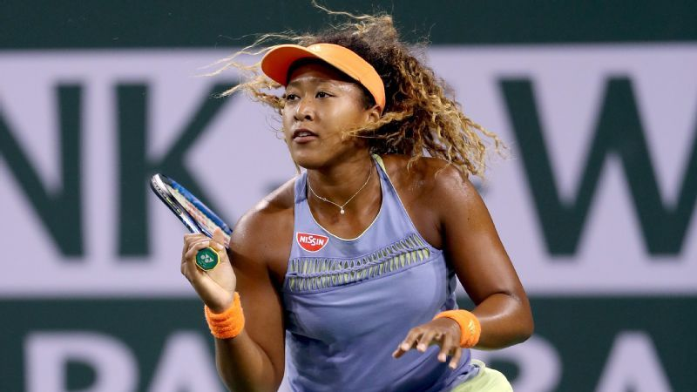
This is Naomi Osaka.
This is ___________.
This is ___ ________.
This is her racket.
She is strong.
She is a good ________.
She is a good tennis player.
I don’t like her.
私は彼女を好きです.
I like her.
私は彼女を好きでわありません.
Notes:
ｊ

Slide 17
GOOD LUCK

