Slide 1
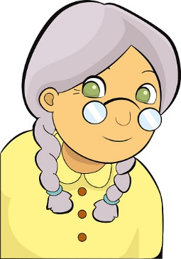
My grandma is quiet. She likes origami.

Slide 2
My grandpa is very active.
He plays golf.

Slide 3
My mom is from China.
She speaks Chinese.

Slide 4
My dad is a chef.
He cooks Italian foods.

Slide 5
My uncle is a pilot.
He fly planes.
flies

Slide 6
My aunt is a teacher.
She goes to school early.

Slide 7
My brother is smart.
He study a lot.
studies

Slide 8
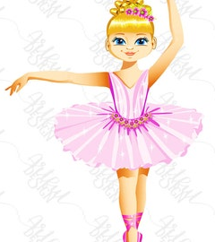
My sister is a ballerina.
She dances well.

Slide 9
My cousin is cheerful.
She has a lot of friends

