Slide 1
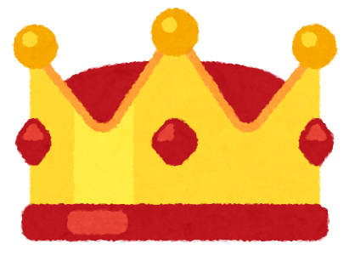
Card King!

Slide 2
There are two types of cards
Question Cards
Answer Cards
Everyone starts with 3 Answer Cards in their hand.

Slide 3
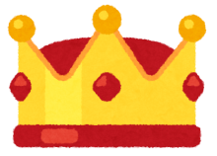
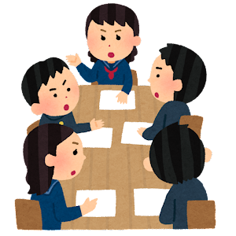
One person is Card King.
Janken to see who will be the first Card King!

Slide 4
The Card King pulls a random Question Card.
____ is my favorite food.

Slide 5
Everyone else chooses an Answer Card and places it face down in front of the Card King.

Slide 6
When all the answers are in, the Card King reads the Answer Cards and chooses the funniest card as the winner.
Old milk is my favorite food.
old milk
____ is my favorite food.
a bowl
of rice
A bowl of rice is my favorite food.
UNIQLO
UNIQLO is my favorite food.
the planet Jupiter
The planet Jupiter is my favorite food.

Slide 7
The winner keeps the Question Card and they are now the Card King.
____ is my favorite food.

Slide 8
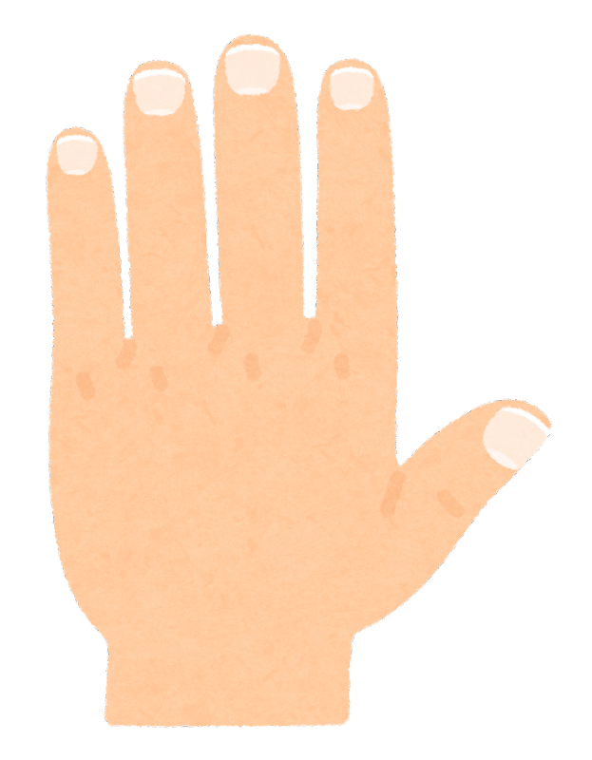
Before the Card King pulls another Question Card, everyone pulls another Answer Card for their hand.
You should always have at least 3 cards in your hand!

Slide 9
Card King Rules
Everyone starts with 3 Answer Cards in their hand.
Janken to see who the first Card King is.
The Card King pulls a random Question Card.
Everyone else chooses an Answer Card and places it face down in front of the Card King.
When all the answers are in, the Card King reads the Answer Cards and chooses the funniest card as the winner.
The winner keeps the Question Card and they are now the Card King.
Before the Card King pulls another Question Card, everyone pulls another Answer Card for their hand.
When the game is over, the winner is the one who has the most Question Cards.

Slide 10
New answer cards!
I will give each of you a blank card.
Write a noun or a noun phrase
Examples:
robots
New York City
a photo of Tina singing
treasure
Write your name at the bottom of the card!

Slide 11
Card King Rules
Everyone starts with 3 Answer Cards in their hand.
Janken to see who the first Card King is.
The Card King pulls a random Question Card.
Everyone else chooses an Answer Card and places it face down in front of the Card King.
When all the answers are in, the Card King reads the Answer Cards and chooses the funniest card as the winner.
The winner keeps the Question Card and they are now the Card King.
Before the Card King pulls another Question Card, everyone pulls another Answer Card for their hand.
When the game is over, the winner is the one who has the most Question Cards.

