Slide 1
Let’s Listen practice Always, usually, sometimes, never

Slide 2
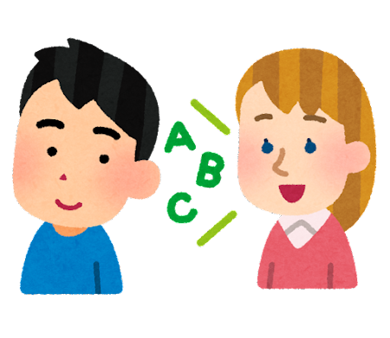
Goal: Practice listening.
Circle what you hear.

Slide 3
1: I (____) sweep the floor.
always
usually
sometimes
never

Slide 4
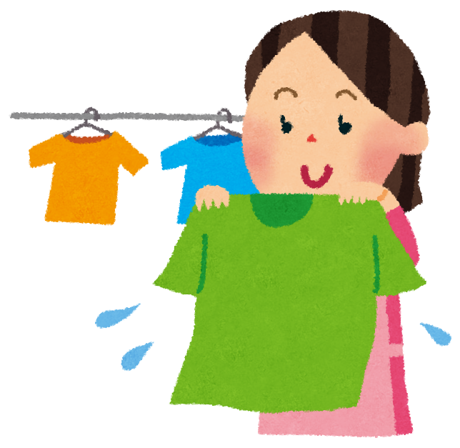
2: I (____) clean my clothes.
always
usually
sometimes
never

Slide 5
3: I (____) cook dinner.
always
usually
sometimes
never

Slide 6
1: I (____) sweep the floor.
always
usually
sometimes
never

Slide 7
2: I (____) clean my clothes.
always
usually
sometimes
never

Slide 8
3: I (____) cook dinner.
always
usually
sometimes
never

