Slide 1
Getting into High School and College in America

Slide 2
The transition from middle school to high school is easy.
In America, it is very uncommon for students to take high school entrance examinations.
Only extremely competitive private high schools would require this.
Most students simply go to the high school that is in their district, or the area where they live.
We don’t have special schools for different careers.

Slide 3
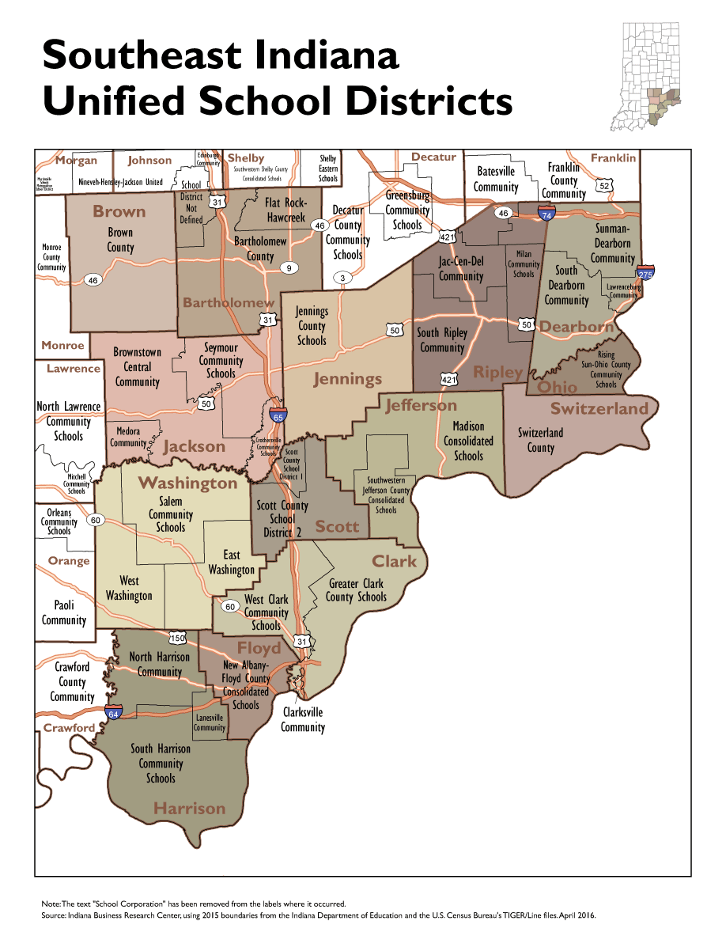
Notes:
You only need to apply to a high school if it is outside of your district. In that case, you will be responsible for your own transportation. The school bus won’t come get you if you go to a school outside your district. So for instance, when I went to high school, I could have gone to the high school in the next town over, Lawrenceburg High School, but I went to the one in my district, because it was much easier, and all of my friends from middle school were going to the same place.

Slide 4
Boarding schools are rare.
Of all the high schools in Indiana, almost 700, only 5 are boarding schools.
Two of those are schools for the blind.
Notes:
Boarding schools are what we call schools with dormitories, that give students the option to live at the school away from home.

Slide 5
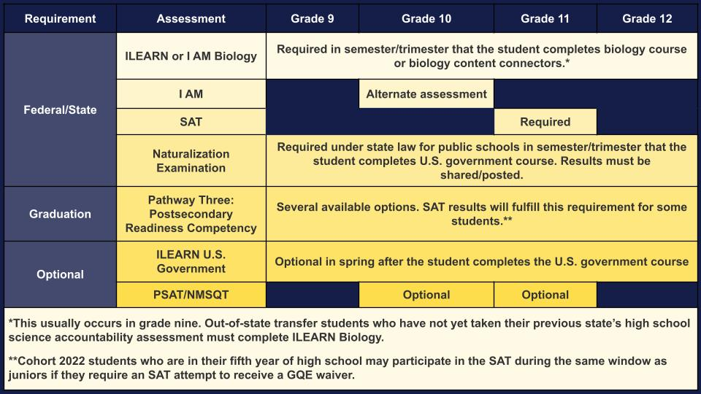
No entrance exams, but we do other tests
Notes:
Testing rules and requirements are different in each state, so I am sticking with Indiana as an example, because that’s where I’m from. We had at least one big test every year, and some smaller ones. And in our Junior year we also had to take the PSAT. Now to talk about the PSAT and SAT.

Slide 6
Exams for College
In high school, we take the PSAT, which is a practice for the SAT.
The SAT is a standard test across the entire country.
1.7 million students in the high school class of 2022 took the SAT
Every high school senior takes the same test and uses it for college applications.
You can take the SAT as many times as you want, but each time, you must pay $60 (~\7,900)
The ACT is another nationally standardized test that students may take, although it is a little less common. Some students take both.

Slide 7
College Requirements & Applications
Seniors in high school will spend a lot of time preparing their college applications.
For many schools, applications are due in the fall during the school year, and announce decisions in the spring
Many colleges require your official grade information, SAT/ACT test score,1-4 letters of recommendation, 1 or 2 long essays, and many, many shorter written answers.
Students can send out as many college applications as they want, but each one will cost $30–$100+ (~\3,900–\13,200+)
Notes:
https://admissions.purdue.edu/apply/criteriafreshmen.php

