Slide 1
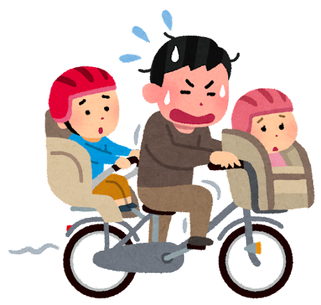
Let’s Review 現在形!

Slide 2
Let’s Review Points of View!
I we
you
he she it they

Slide 3
-s, -es, -ies is for singular third person pronouns
I like cake. You like cake. Ken/He likes cake.
We study English. You study English. The dog studies English.
I go to school. You go to school. They go to school.
It
They is NOT singular

Slide 4
it = the pencil
The pencil (write / writes) well.

Slide 5
The pencils (write / writes) well.

Slide 6
They – They (ride / rides) a bike to school.

Slide 7
He – He (like / likes) katanas.

Slide 8
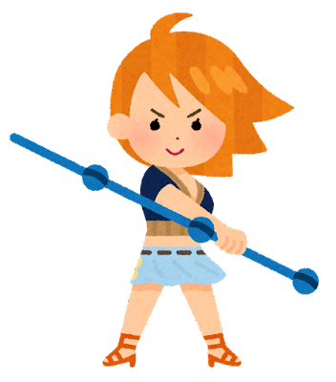
She – She (have / has) orange hair.

Slide 9
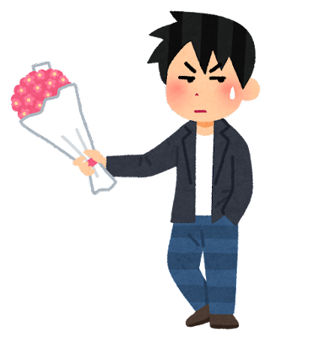
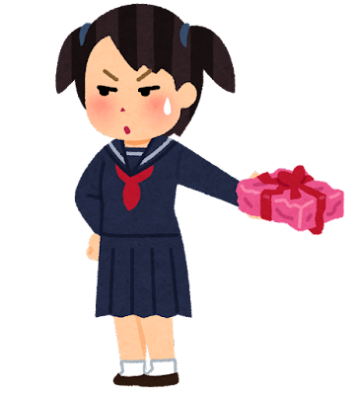
We they We/They (like / likes) each other.

Slide 10
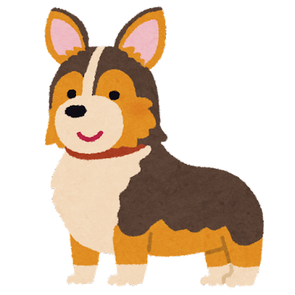
It = the dog The dog (is / are) cute!

Slide 11
The dogs (is / are) cute!

