Slide 1
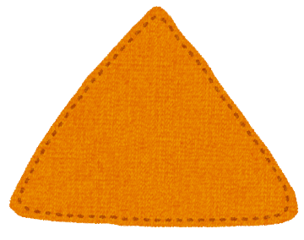
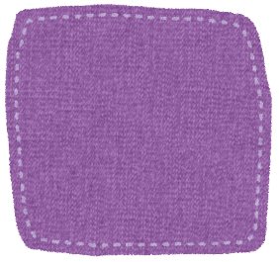
Shapes word search!
A G S S G B X M T Y S D C K T H F V I E Q H Q G
I B A U T G C N B E U H
R T R I A N G L E A A M
C T U O E K B C Z R R L L W V Y B E Z X Y T E M
E D F R E C T A N G L E
TRIANGLE SQUARE RECTANGLE CIRCLE STAR HEART

Slide 2
Shapes word search!
A G S S G B X M T Y S D C K T H F V I E Q H Q G
I B A U T G C N B E U H
R T R I A N G L E A A M
C T U O E K B C Z R R L L W V Y B E Z X Y T E M
E D F R E C T A N G L E
TRIANGLE SQUARE RECTANGLE CIRCLE STAR HEART

