Slide 1
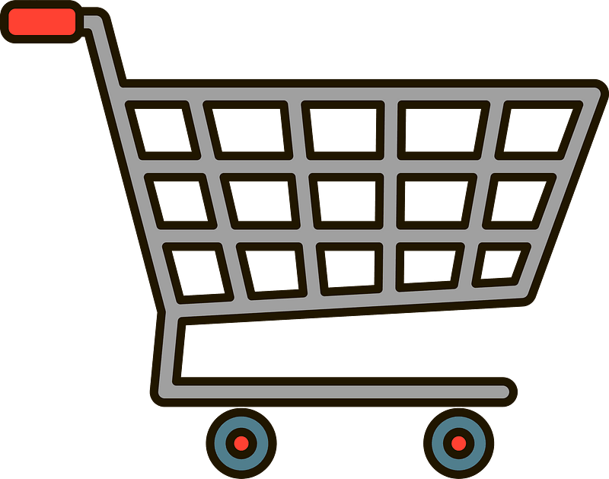
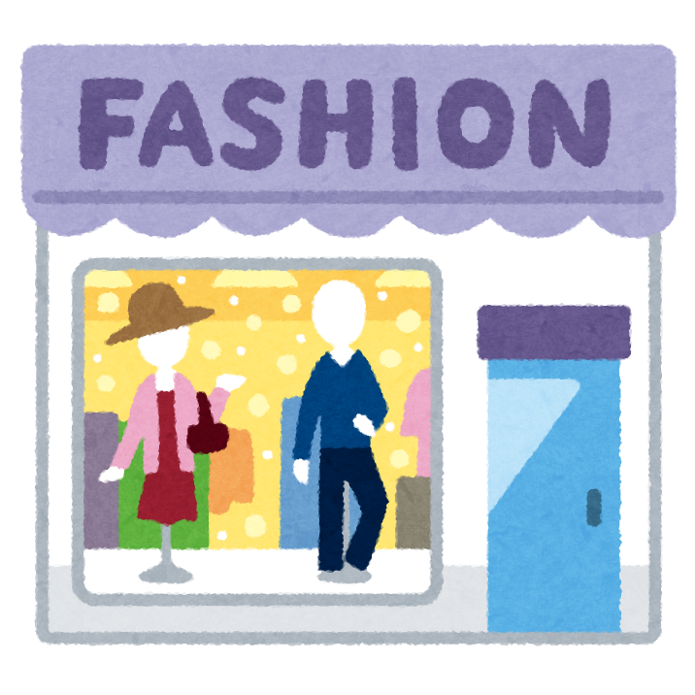
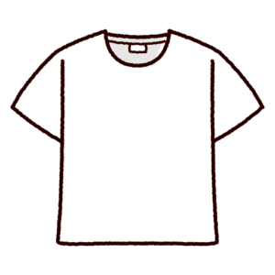
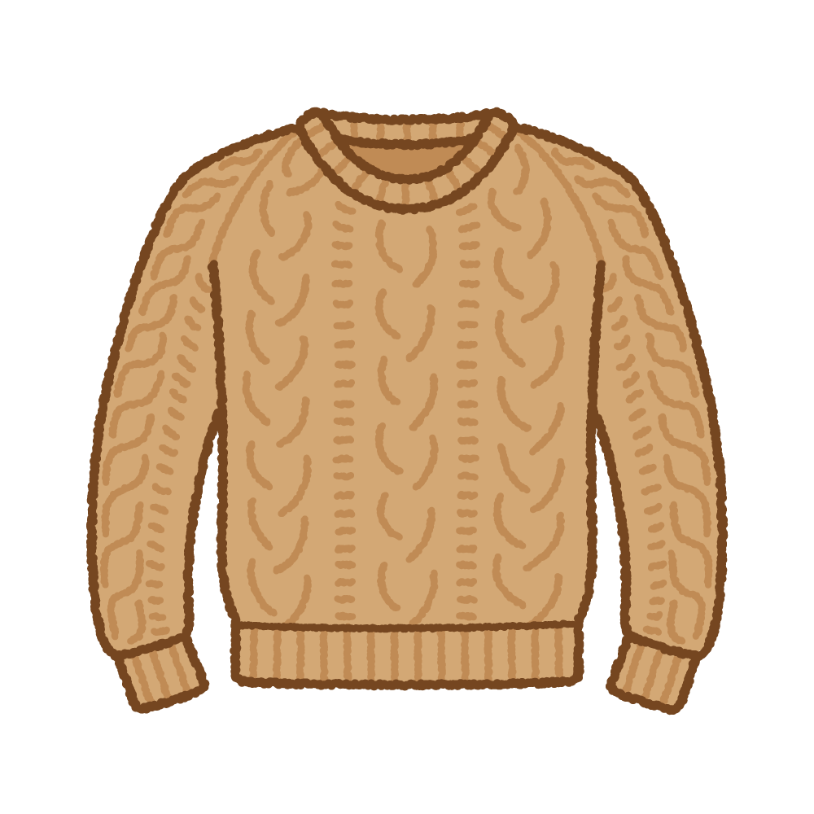
買い物リスト
自分の店
MY SHOPPING LIST
MY SHOP
#1 Bag: _________________
#2 T-Shirt: ______________
#3 Jacket: ______________
#4 Sweater: ____________
BAG
T-SHIRT
#1
#3
#2
#4
$25
$12
JACKET
SWEATER
$58
$34

Slide 2
S

