Slide 1
On/In/By/Under
GAME!

Slide 2
By the
Table

Slide 3
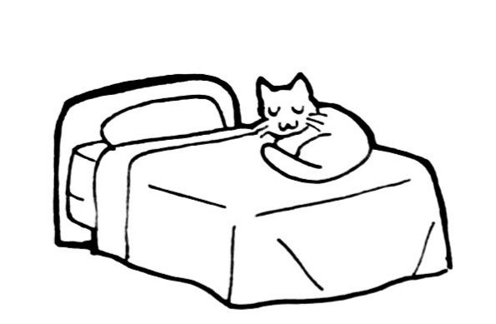
On the
Bed

Slide 4
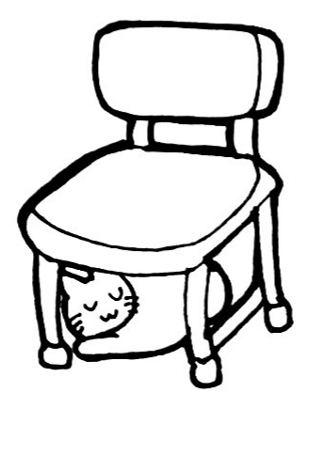
Under the
Chair

Slide 5
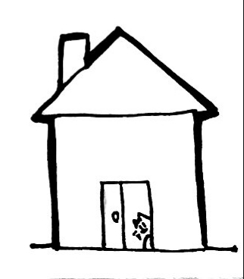
In the
House

Slide 6
In the
Car

Slide 7
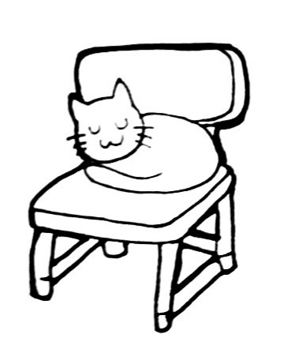
On the
Chair

Slide 8
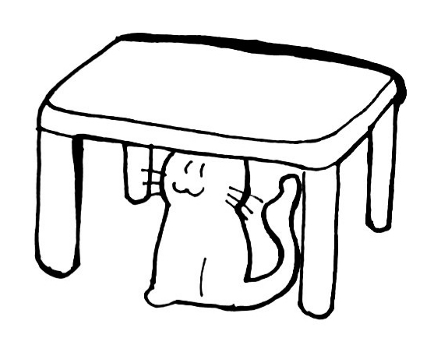
Under the
Table

Slide 9
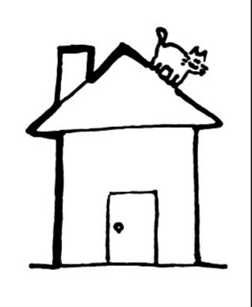
On the
House

Slide 10
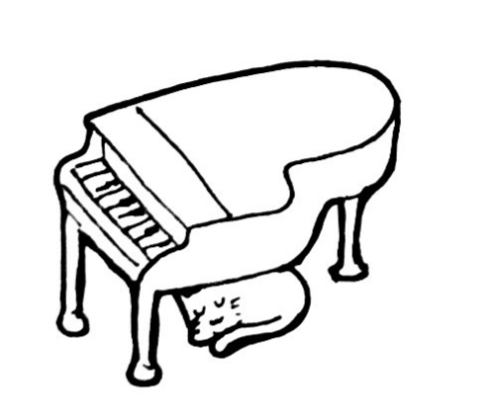
Under the
Piano

Slide 11
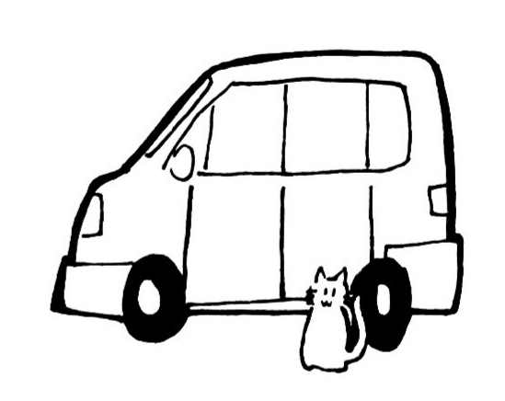
By the
Car

Slide 13
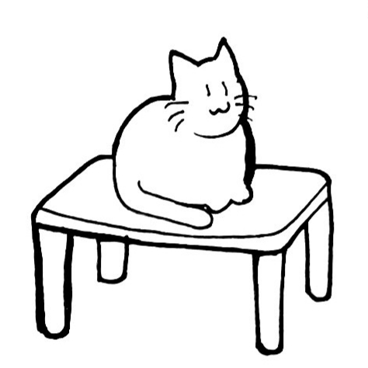
On the
Table

Slide 14
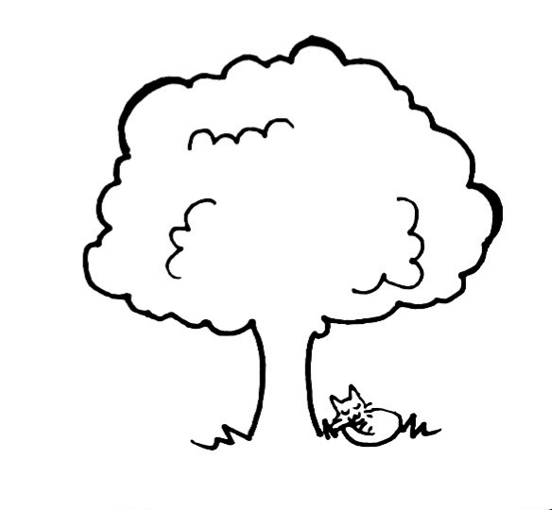
Under the
Tree

Slide 15
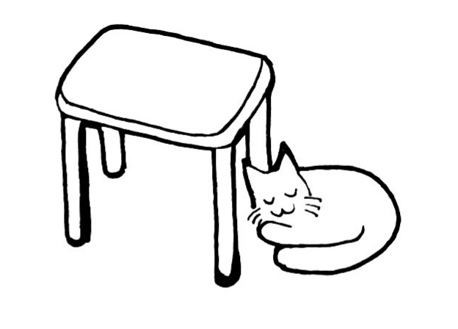
By the
Table

Slide 16
Under the
Umbrella

Slide 17
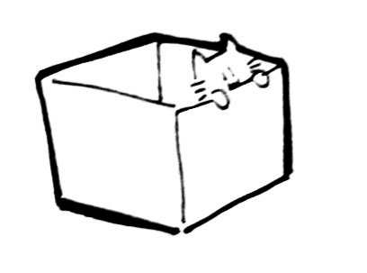
In the
Box

Slide 18
On the
Toilet

Slide 19
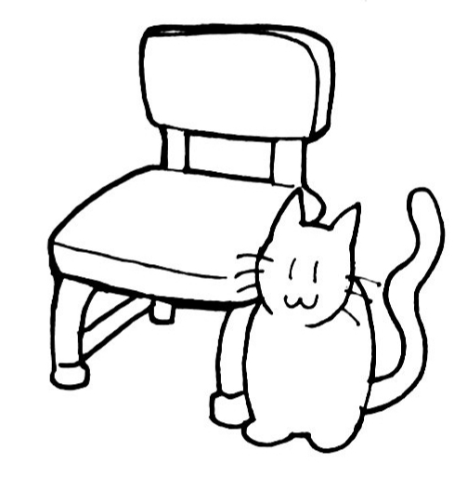
By the
Chair

Slide 20
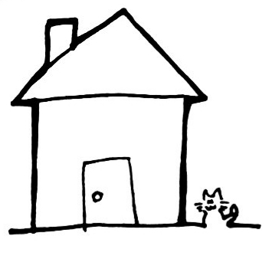
By the
House

