Slide 1
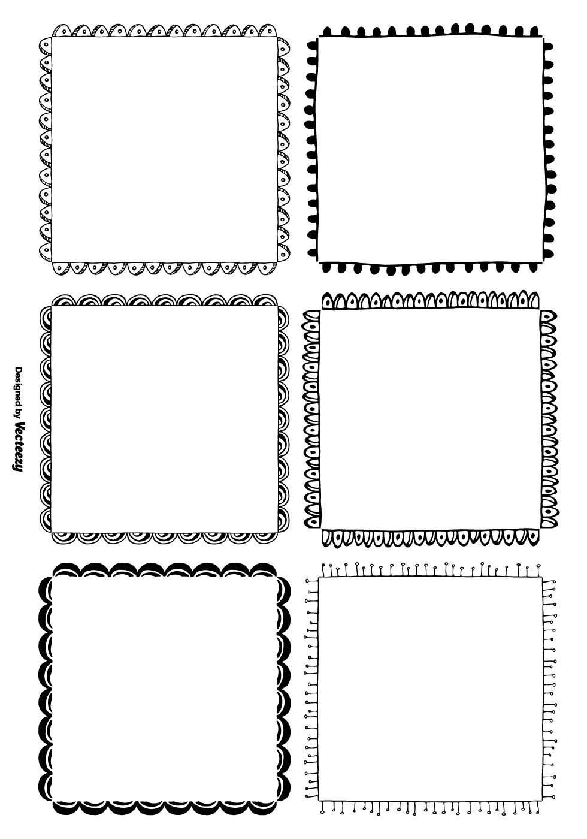
Start!
1. Ask a question and get a yes or no answer.
2. Ask a question and get an answer that has a number.
3. Ask a question and get a place for the answer.
4. Ask a question starting with “Can you…”
Rules:
No writing!
Ask the person to your right.
5. Ask a question starting with “Do you…”
6. Ask a question starting with “Do you think…”

Slide 2
A. Say the days of the week backwards.
B. Say the days of the week in alphabetical order.
C. Say the months of the year backward. (December start)
D. Say the months of the year in alphabetical order.
E. Say the months of the year in backward alphabetical order.
F. Say two words for every letter in your name.
G. Make a Haiku about **your school**.
H. A doctor’s brother moved to America. What is the doctor to the brother? (Answer is not brother)
I. Billy’s mother had five children. The first was named Lala, the second was named Lele, the third was named Lili, the fourth was named Lolo. What was the fifth child named?
J. You can find it in Mercury, Earth, Mars, Jupiter and Saturn, but not in Venus or Neptune. What is it?
K. Say 5 words that have exactly 10 letters.
L. Say 5 places that start with ‘L.’
M. Say 10 things you can wear.
N. Say 10 objects in this room.
O. Say 5 things you can open.
P. Say 5 things you can push or pull.
Q. Say 5 famous landmarks abroad.
Challenge Map
red blue green brown
green red brown blue
blue brown green red
red blue green brown

Slide 3
This is an English speaking game for ESL high school students. Could also work for college students or maybe middle school.
Materials Needed:
1 Game board (page 1) per group.
1 Challenge Map (page 2) printed in color per teacher/aide.
1 Die per group.
Game Play:
Groups start from the top left number 1 and roll their die to get a box on the right. They should ask a question corresponding to their box to the person on their right. If they meet the box qualifications, they can move that number of spaces. Then it’s the person to their right’s turn. If they land on a 7 on the ring, they raise their hand to do a challenge from the Challenge Map. If they complete the challenge, they get a point for their group. If you have a large class, you may want to adjust the numbers on the ring so you don’t get overwhelmed. Don’t forget to print in color so they can do the Stroop Test.

