Slide 1
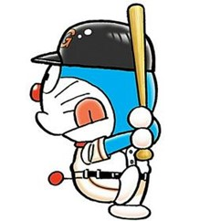
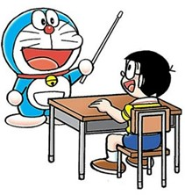
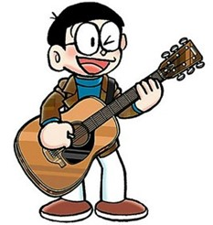
START/
GOAL
a baseball
player
an astronaut
a teacher
a soccer
player
a dancer
What do you want
to be?
a chef
a farmer
I want to be…
a nurse
a singer
a train engineer
a police officer
an architect
a musician
an artist

