Slide 1
Jeopardy
Unit5

Slide 2
Jeopardy -Unit5-
English ↓ Japanese | Japanese ↓ English | Scramble words | Questions | Contents
100 | 100 | 100 | 100 | 100
200 | 200 | 200 | 200 | 200
300 | 300 | 300 | 300 | 300
400 | 400 | 400 | 400 | 400
500 | 500 | 500 | 500 | 500

Slide 3
Jeopardy English-Japanese100
shampoo
シャンプー

Slide 4
Jeopardy English-Japanese200
in need
困っている

Slide 5
Jeopardy English Japanese300
Which bus goes to
Sunayama beach?
どのバスが砂山ビーチ行きですか？

Slide 6
Jeopardy English-Japanese400
When you are busy,
I will help you.
あなたが忙しいとき、私が手伝いましょう。

Slide 7
Jeopardy English-Japanese500
If you are interested,
we will send you a catalog.
もし興味があれば、カタログを送りましょう。

Slide 8
Jeopardy Japanese-English100
髪
hair

Slide 9
Jeopardy Japanese-English200
～に乗る
get on

Slide 10
Jeopardy Japanese-English300
今日初めてパンダを見ました。
I saw panda ( )
today. 〈４語〉

Slide 11
Jeopardy Japanese-English400
あなたが困っているときは
私が手を貸しましょう。
When you are in need, I will help you.

Slide 12
Jeopardy Japanese-English500
暑かったので私は窓を開けました。
I opened the window because it was hot.
Because it was hot, I opened the window.

Slide 13
Jeopardy scramble words100
v - e - n - e
even

Slide 14
Jeopardy scramble words200
a - e - i -d
idea

Slide 15
Jeopardy scramble words300
a - e - h - p - s
shape

Slide 16
Jeopardy scramble words400
a-b-c-e-e-s-u
because

Slide 17
Jeopardy scramble words500
h-h-e-e-a-c-
i-l-r-w
wheelchair

Slide 18
Jeopardy Questions100
If it’s sunny tomorrow,
What will you do?
I will ~~~.

Slide 19
Jeopardy Questions200
What sports do you like?
Why?
I like ~ because ….

Slide 20
Jeopardy Questions300
What was your mother doing
when you got home yesterday?
She was ~~~.

Slide 21
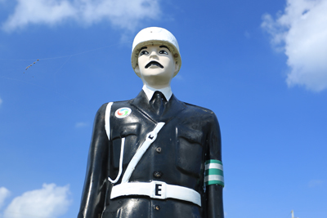
Jeopardy Questions400
What do you think?
I think ~~~.

Slide 22
Jeopardy Questions500
How long does it take from
Kita JHS to Miyako Airport?
It takes about ~ minutes.

Slide 23
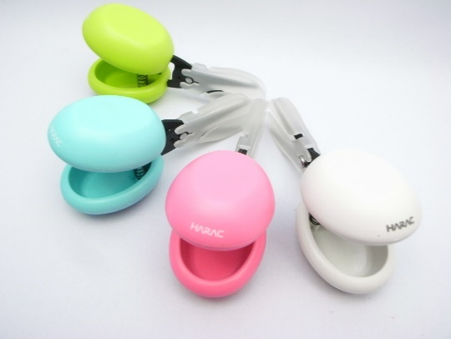
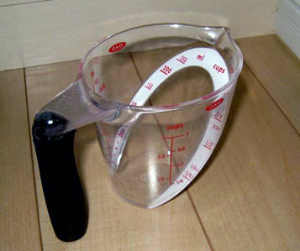
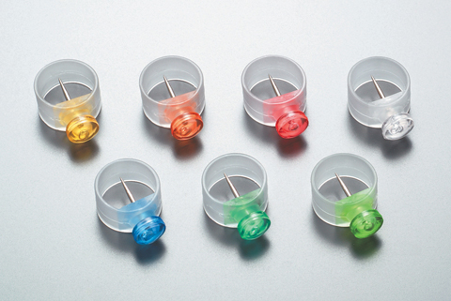
Jeopardy Contents100
What are they?
Universal design products.

Slide 24
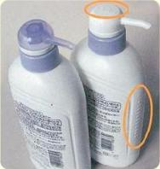
Jeopardy Contents200
What does
shampoo bottle have?
It has bumps.

Slide 25
Jeopardy Contents300
Could Saki use
the wheelchair easily?
No, she couldn’t.

Slide 26
Jeopardy Contents400
What can you use
if you’re in a wheelchair?
You can use the ramp.

Slide 27
Jeopardy Contents500
Which bus goes
to the Palace Theater?
Bus No. 104.

