Slide 1
1 one of hearts | 2 two of hearts | 3 three of hearts | 4 four of hearts | 5 five of hearts
6 six of hearts | 7 seven of hearts | 8 eight of hearts | 9 nine of hearts | 10 ten of hearts
J Jack of hearts | Q Queen of hearts | K King of hearts | Joker

Slide 2
1 one of diamonds | 2 two of diamonds | 3 three of diamonds | 4 four of diamonds | 5 five of diamonds
6 six of diamonds | 7 seven of diamonds | 8 eight of diamonds | 9 nine of diamonds | 10 ten of diamonds
J Jack of diamonds | Q Queen of diamonds | K King of diamonds

Slide 3
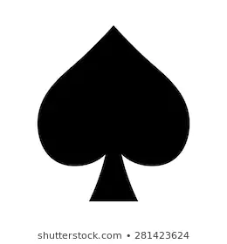
1 one of spades | 2 two of spades | 3 three of spades | 4 four of spades | 5 five of spades
6 six of spades | 7 seven of spades | 8 eight of spades | 9 nine of spades | 10 ten of spades
J Jack of spades | Q Queen of spades | K King of spades | Joker

Slide 4
1 one of clubs | 2 two of clubs | 3 three of clubs | 4 four of clubs | 5 five of clubs
6 six of clubs | 7 seven of clubs | 8 eight of clubs | 9 nine of clubs | 10 ten of clubs
J Jack of clubs | Q Queen of clubs | K King of clubs

Slide 5
1 one of hearts | 2 two of hearts | 3 three of hearts | 4 four of hearts | 5 five of hearts
6 six of hearts | 7 seven of hearts | 8 eight of hearts | 9 nine of hearts | 10 ten of hearts
J Jack of hearts | Q Queen of hearts | K King of hearts

