Slide 1
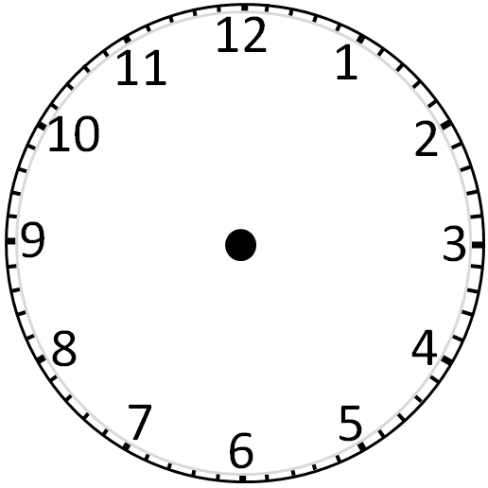
A.M
A.M
A.M
A.M
A.M
A.M
A.M
A.M
A.M
A.M

Slide 2
P.M
P.M
P.M
P.M
P.M
P.M
P.M
P.M
P.M
P.M

Slide 3
It's 10 A.M |  | It's 11 A.M
It's 10 P.M |  | It's 11 P.M
A.M
A.M
P.M
P.M

Slide 4
It's 12 A.M |  | It's 1 A.M
It's 2 A.M |  | It's 3 A.M
It's 4 A.M |  | It's 5 A.M
It's 6 A.M |  | It's 7 A.M
It's 8 A.M |  | It's 9 A.M

Slide 5
It's 12 P.M |  | It's 1 P.M
It's 2 P.M |  | It's 3 P.M
It's 4 P.M |  | It's 5 P.M
It's 6 P.M |  | It's 7 P.M
It's 8 P.M |  | It's 9 P.M

Slide 6
DOWN

Slide 7
U
P

