Slide 1
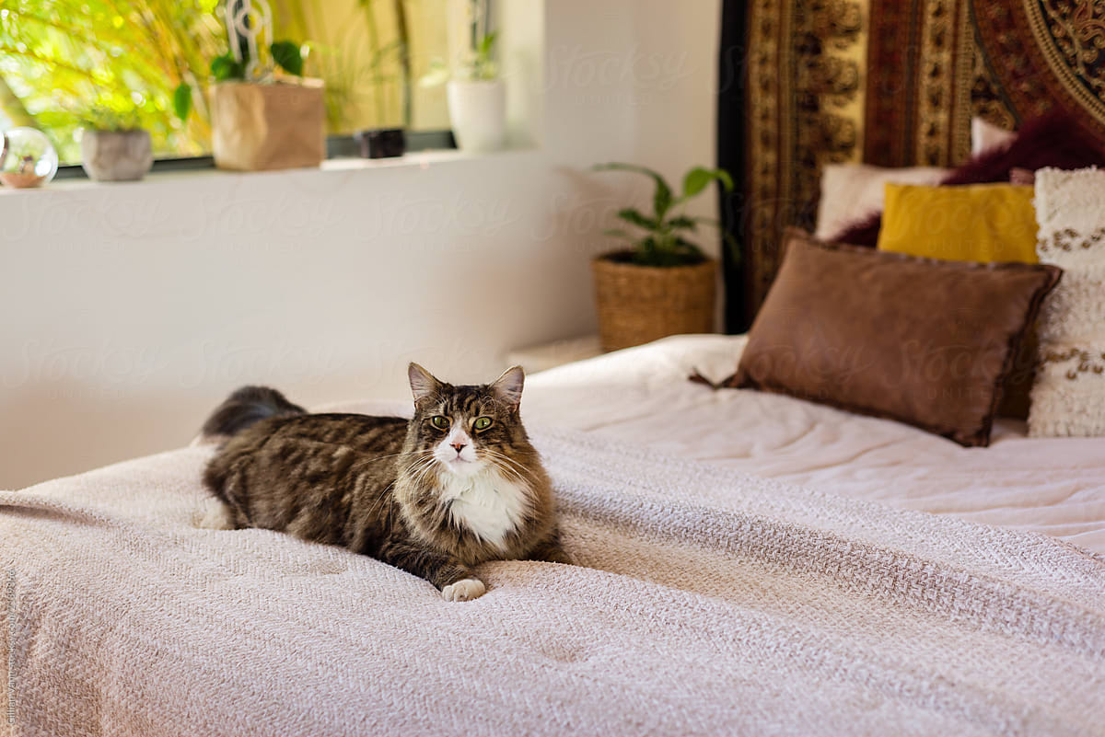
What do you see?
There is a cat on the bed.

Slide 2
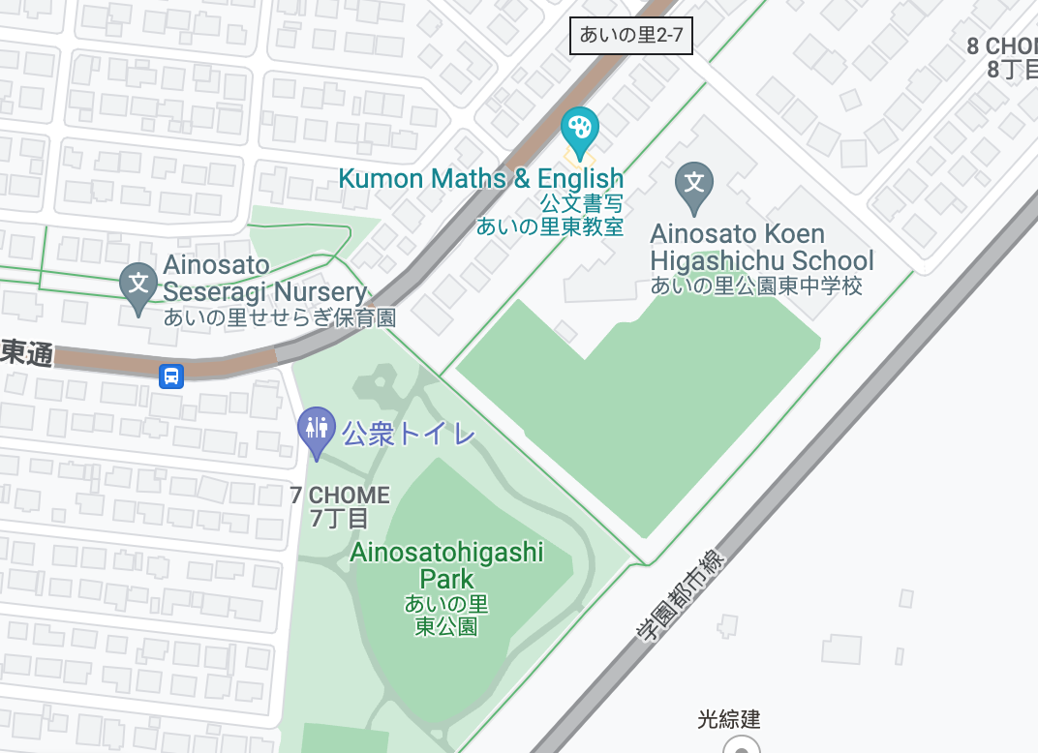
What do you see?
There is a park near the school.

Slide 3
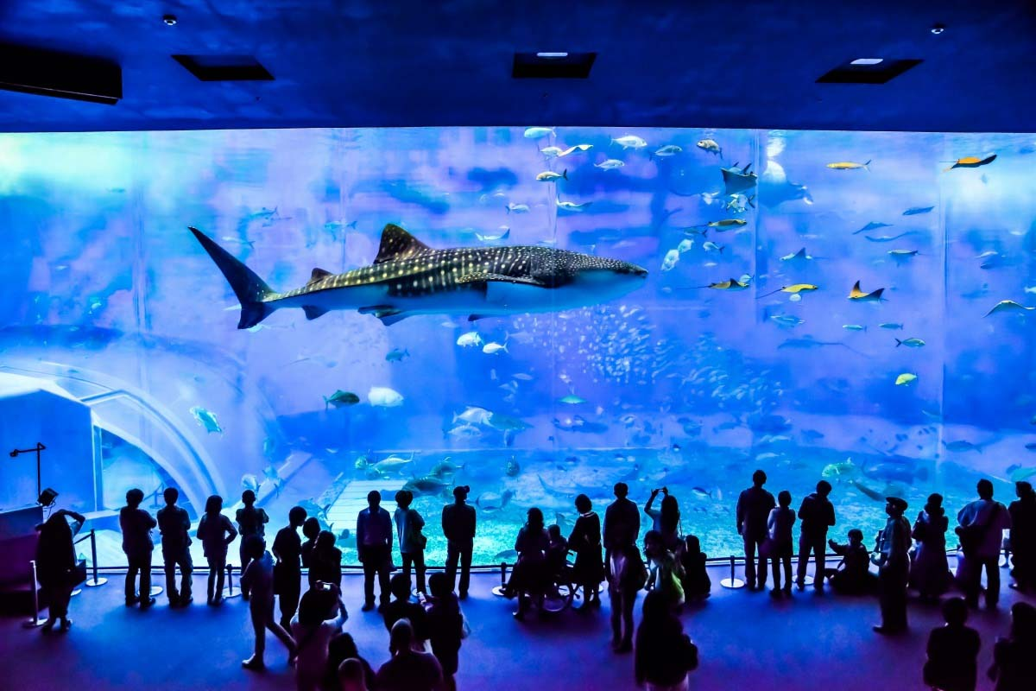
I will visit Okinawa. What can I see?
There is an aquarium in Okinawa.

Slide 4
What do you see?
There are 12 books on the shelf.
Is there a blue book on the shelf?
Yes there is.

Slide 5
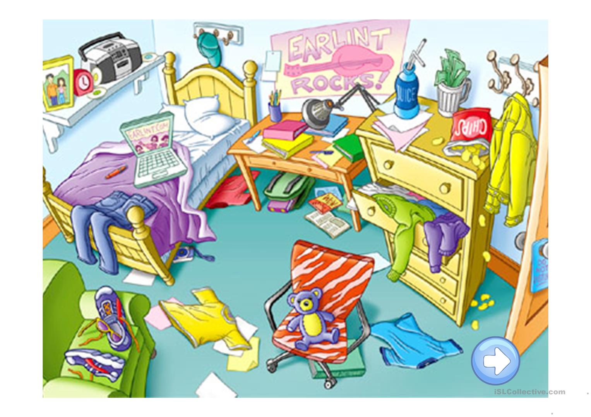
What do you see?

Slide 6
Quiz Time!

Slide 7
Example
Is there a book under the chair?
Yes, there is.
There is a book under the chair.
1 point

Slide 8
Is there a bear on the chair?
Yes, there is.
There is a bear on the chair.
3 points

Slide 9
Is there a bag under the bed?
No, there isn’t.
There is a bag under the table (desk).
2 points

Slide 10
Are there shoes on the chair?
Yes, there are.
There are shoes on the chair.
2 points

Slide 11
Is there cola on the dresser?
No, there isn’t.
There is juice on the dresser.
5 points

Slide 12
Is there a camera under the bed?
Yes, there is.
There is a camera under the bed.
2 points

Slide 13
Is there a red shirt under the bed?
Yes, there is.
There is a red shirt under the bed.
3 points

Slide 14
Is there a pen on the chair?
No, there isn’t.
There is a pen on the bed.
2 points

Slide 15
Are there chips on the dresser?
Yes, there are.
There are chips on the dresser.
4 points

Slide 16
Is there a clock on the shelf?
Yes, there is.
There is a clock on the shelf.
3 points

Slide 17
Is there a computer on the table (desk)?
No, there isn’t.
There is a computer on the bed.
5 points

