Slide 1
Rules
Santa = woman AKA you win all the cards in the discard pile
Black Santa = bouzu AKA you lose all your cards to the discard pile (You can also change to Dark Santa, but Black is easier for students to say and understand)
Candy, presents, cookies, cake = man AKA nothing happens, discard and the next person flips a card

Slide 2
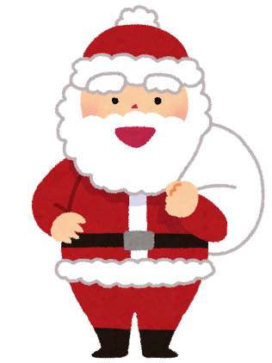
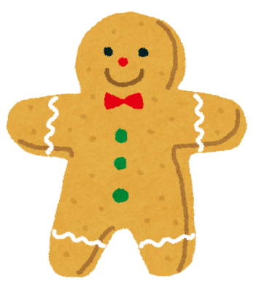
Santa
Santa
Santa
Santa
Santa
Gingerbread
Gingerbread
Gingerbread
Gingerbread
Gingerbread

Slide 3
Santa
Santa
Santa
Santa
Santa
Gingerbread
Gingerbread
Gingerbread
Gingerbread
Gingerbread

Slide 4
Present
Present
Present
Present
Present
Candy Cane
Candy Cane
Candy Cane
Candy Cane
Candy Cane

Slide 5
Present
Present
Present
Present
Present
Candy Cane
Candy Cane
Candy Cane
Candy Cane
Candy Cane

Slide 6
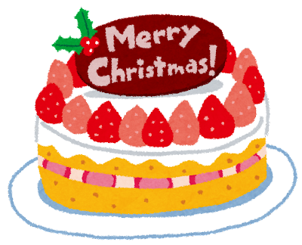
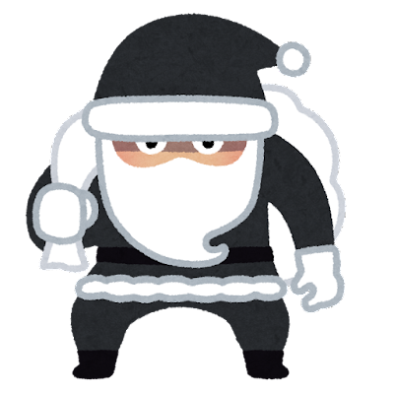
Christmas Cake
Christmas Cake
Christmas Cake
Christmas Cake
Christmas Cake
Black Santa
Black Santa
Black Santa
Black Santa
Black Santa

Slide 7
Christmas Cake
Christmas Cake
Christmas Cake
Christmas Cake
Christmas Cake
Black Santa
Black Santa
Black Santa
Black Santa
Black Santa

