Slide 1
Guess the Animal

Slide 2
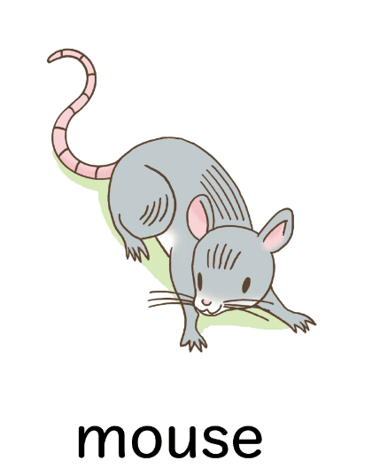
Who are you?
I am small.
I have long tail.
I like cheese.

Slide 3
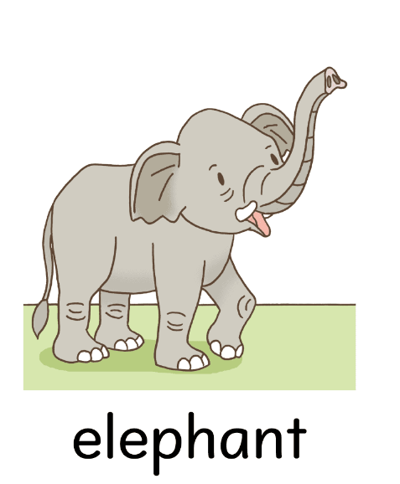
Who are you?
I have big ears.
I have long nose.
I am big.

Slide 4
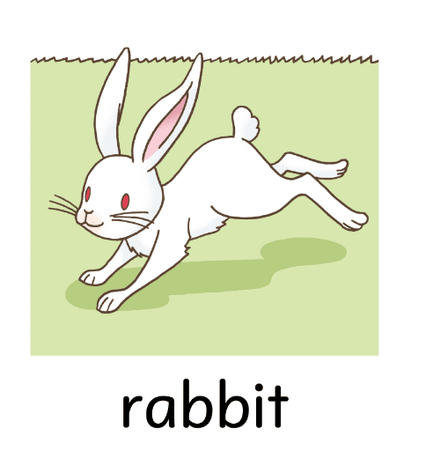
Who are you?
I am small.
I like carrots.
I like to jump.

Slide 5
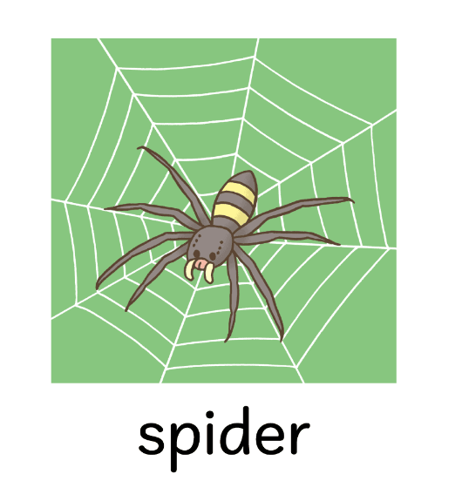
Who are you?
I am small.
I have 8 legs.
I make my own home called “web”.

Slide 6
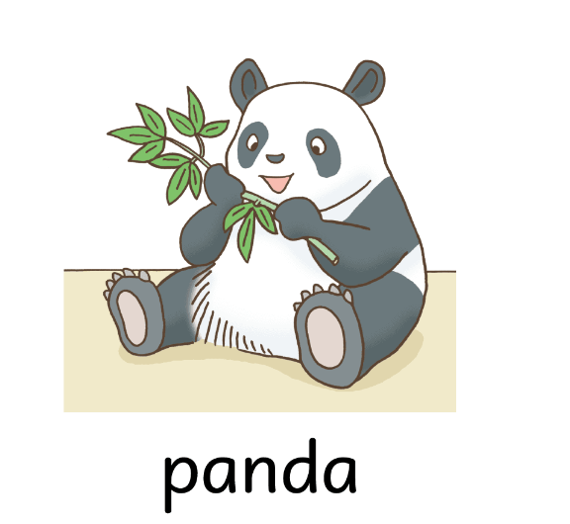
Who are you?
I'm cute.
I like bamboo.
I am color black and white.

Slide 7
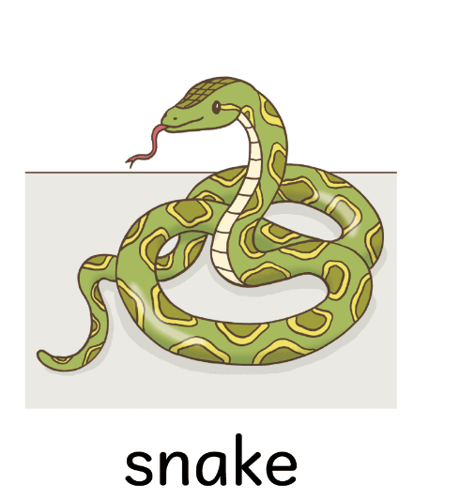
Who are you?
I live in the forest.
I am long.
I don’t have legs.

Slide 8
Who are you?
I have long tail.
I like to climb trees.
I like bananas.

