Slide 1
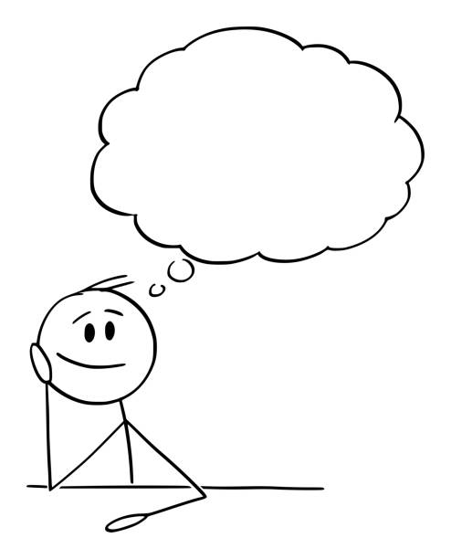
Today’s Topics

Slide 2
I want to go to Paris.

Slide 3
I like to drink coffee.

Slide 4
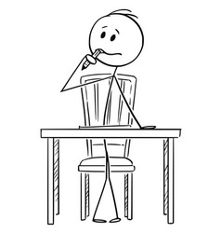
I don’t want to study.

Slide 5
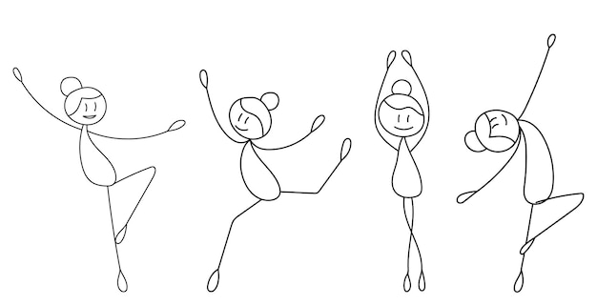
Do you want to dance?

Slide 6
What do you like to do?

Slide 7
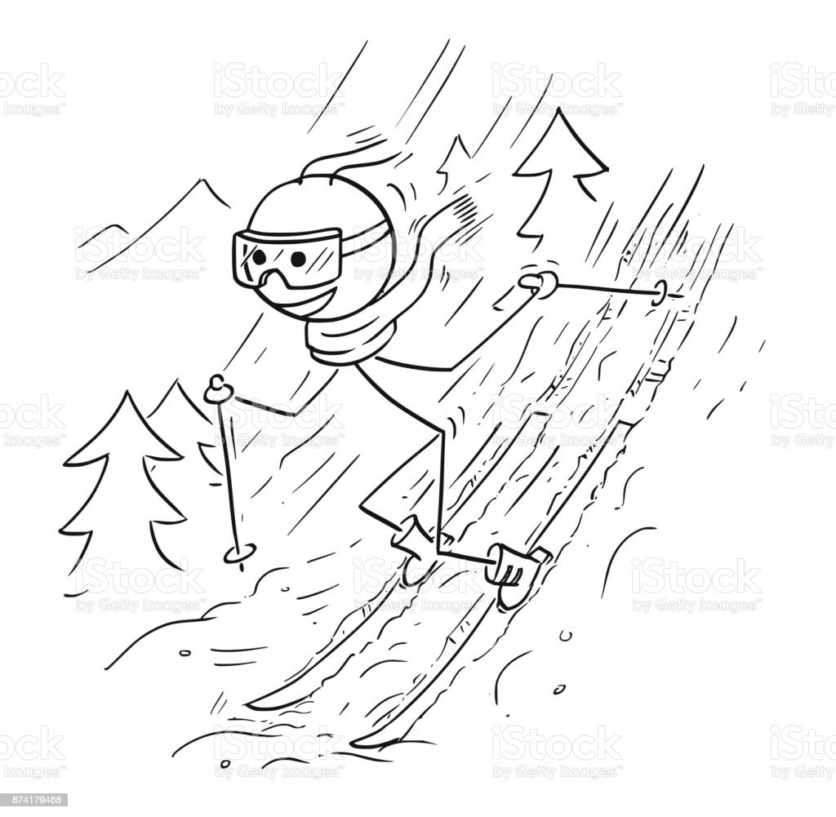
My friend likes to ski.

Slide 8
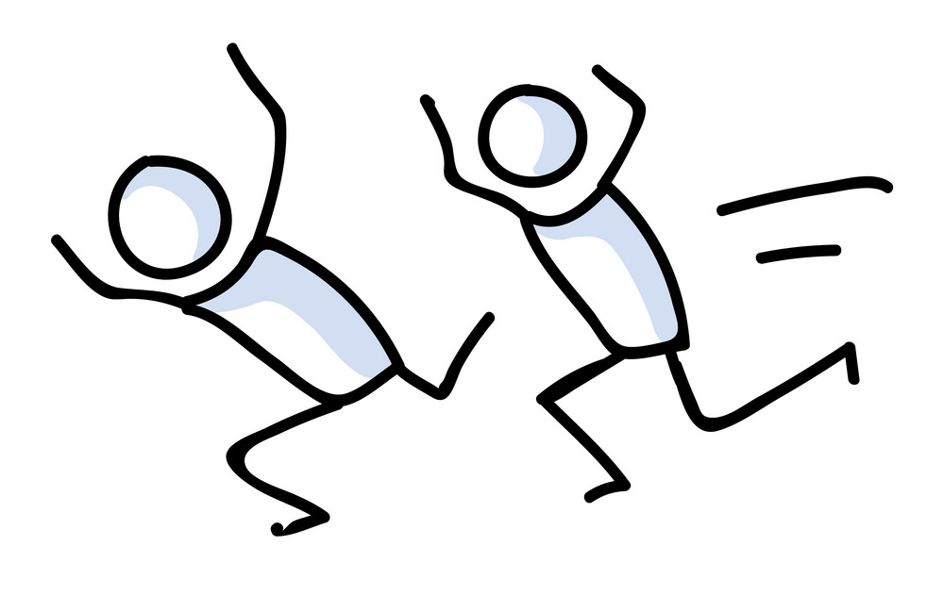
Let’s practice!

Slide 9
STICK RACES

Slide 10
Do you want to study English this summer?
Yes, I do.
Do you want to eat sushi this summer?
No, I don’t.

Slide 11
ONE MORE!

Slide 12
What do you like to cook?
I like to cook pizza.

Slide 13
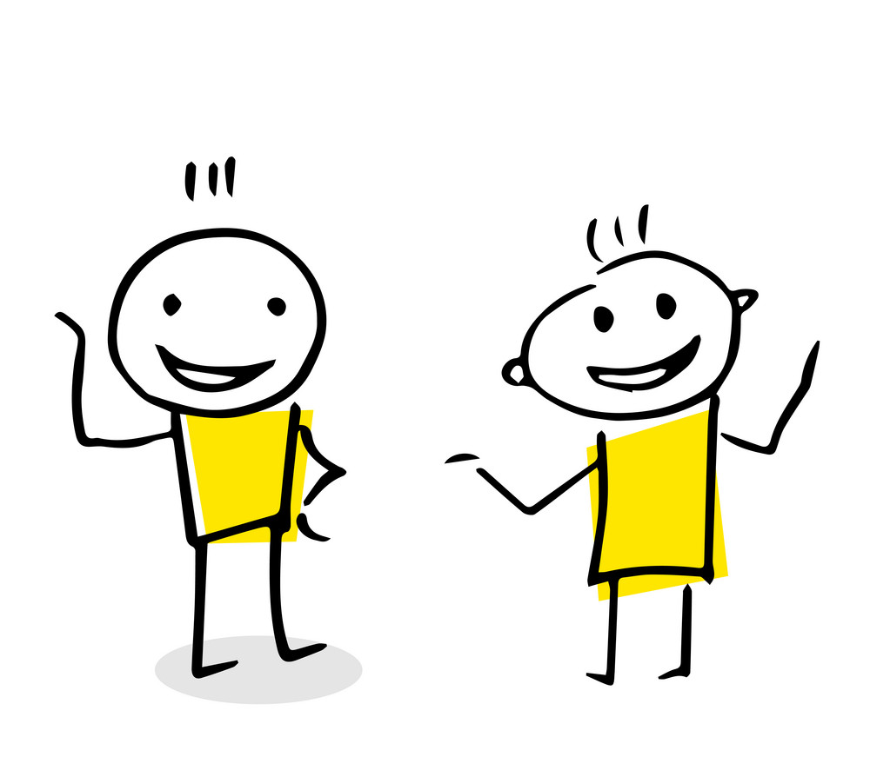
NEXT

Slide 14
TALK TIME

Slide 15
ONE

Slide 16
What do you want to __ this summer?
I want to…
I think it will be ..
Why?
Who?
Where?
What?
When?
How?

Slide 17
ONE MORE!

Slide 18
What do you like to __?
I like to __ __
Why?
Who?
Where?
What?
When?
How?

Slide 19
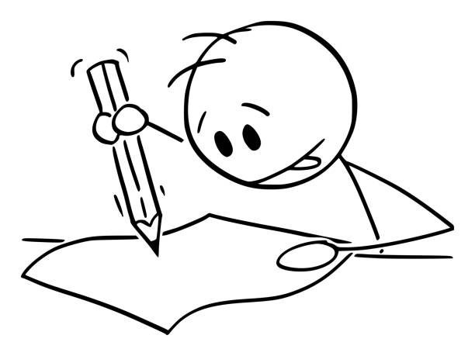
LAST

Slide 20
WRITE IT!

Slide 21
What do you like to do in the summer?
I like to go to the beach.
I usually go with my family.
I think the sea is very beautiful.

Slide 22
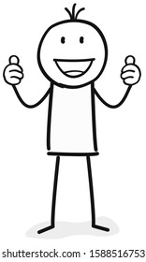
GOOD LUCK!

