Slide 1
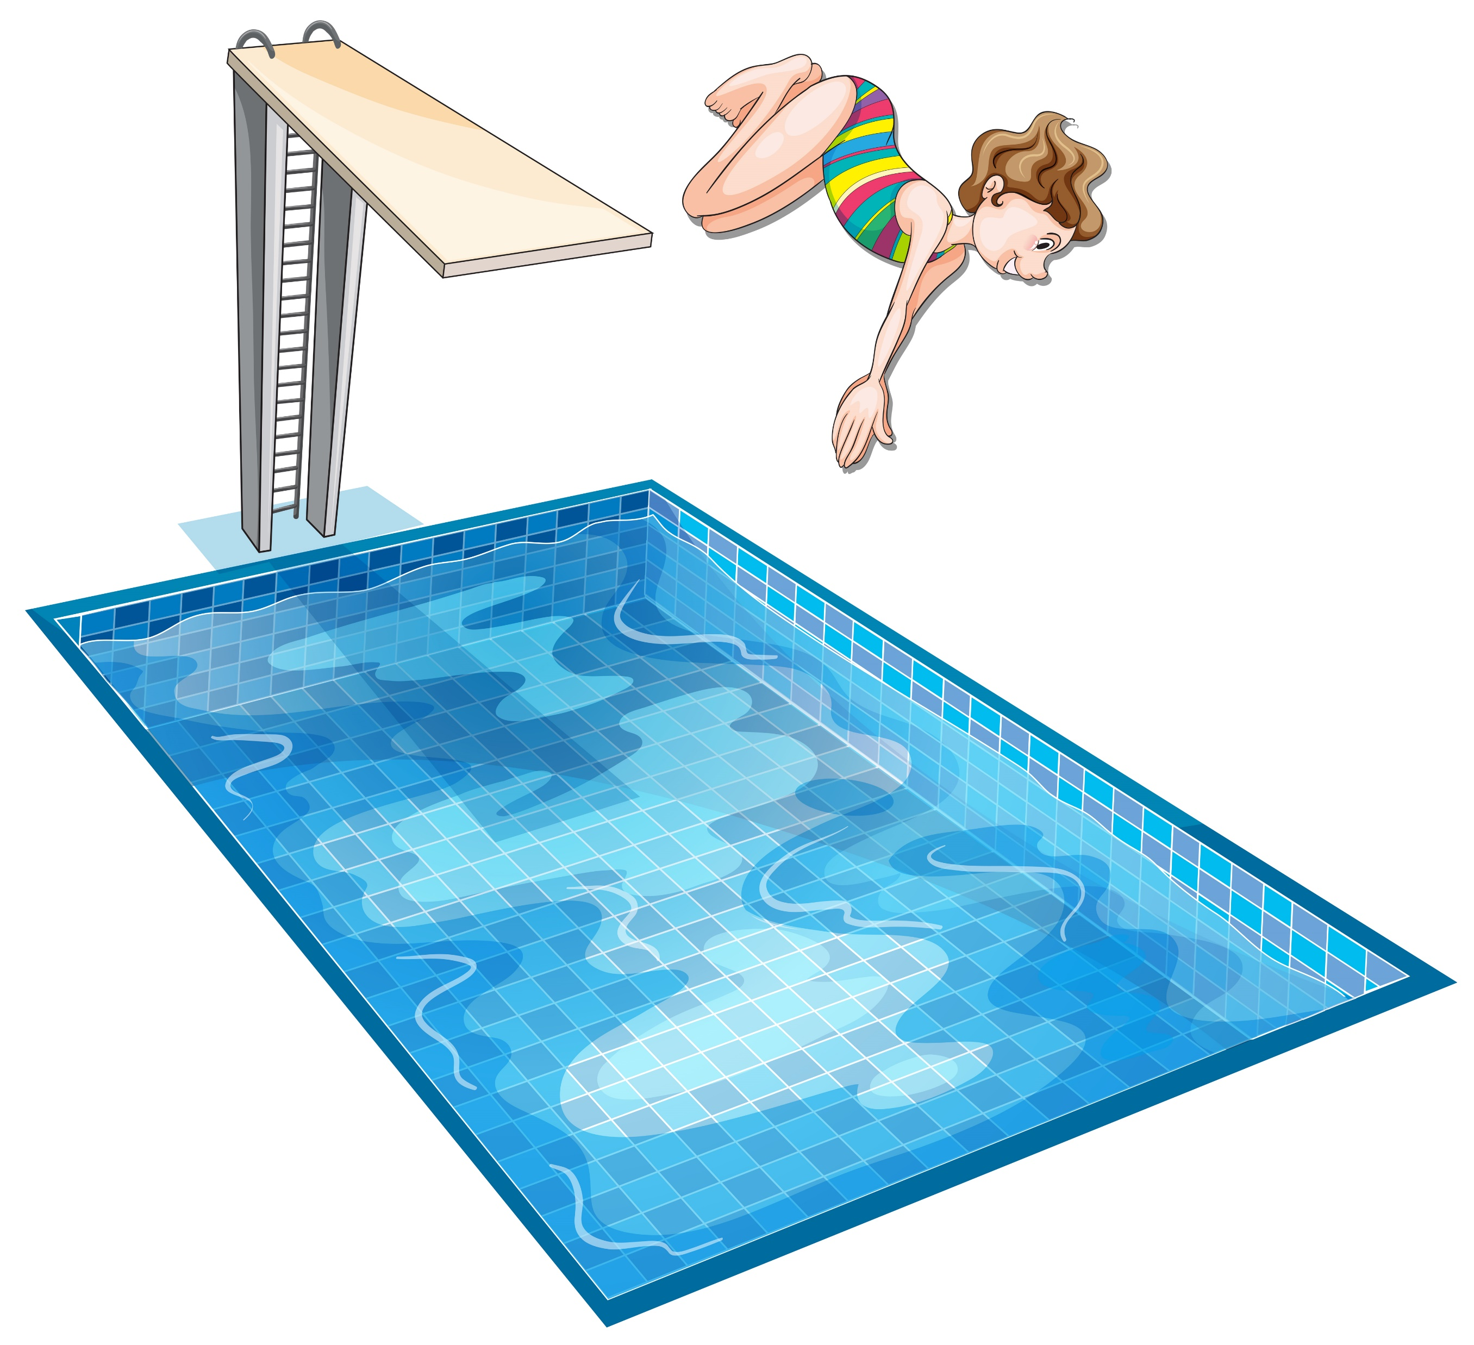
Class:____ No: ____ Name:
May I Dive in the Pool?
Should I use the ladder?
You use the ladder.
May I dive in the pool?
You dive in the pool.
Things you must and must not do… 今日のルールで確認する
1.
May I eat at the pool?
You eat at the pool.
2.
Should I watch my children swim?
You your children swim.
3.
May I bring my dogs to the pool?
You to the pool.
4.
Can I smoke near the pool?
You near the pool.
5.
Should I shower before I swim?
You before you swim.
6.
What should I wear in the pool?
You wear a , , and .
7.
Can I use the pool alone at night?
You
8.
How can I stay safe on the pool deck?
You use and be .
9.
Can I pee in the pool?
You the pool. Use ,

