Slide 1
keys
_eys

Slide 2
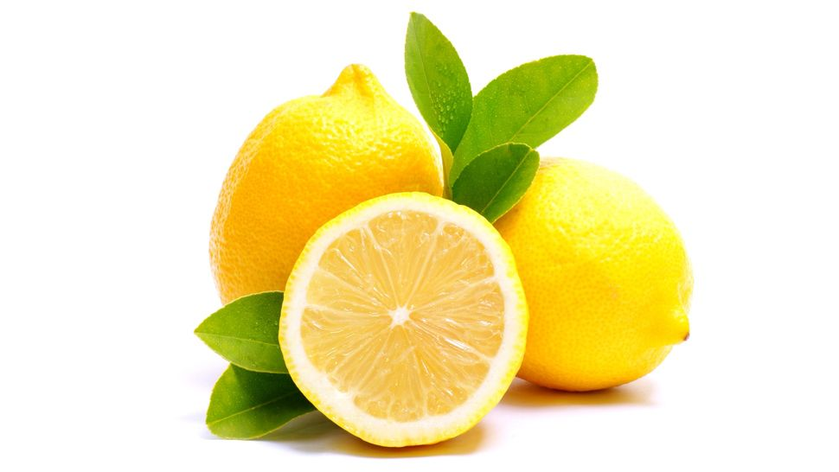
lemon
_emon

Slide 3
heart
_eart

Slide 4
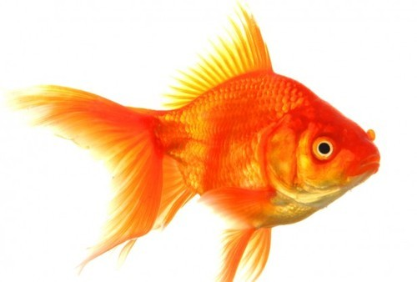
fish
_ish

Slide 5
And last…

Slide 6
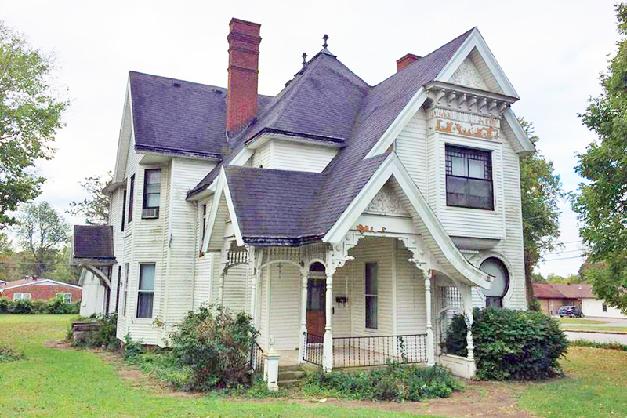
house
_ouse

