Slide 1
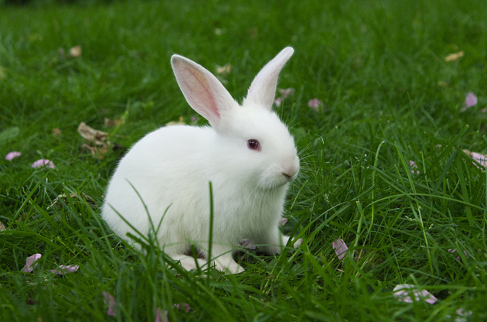
rabbit
_abbit

Slide 2
test
_est

Slide 3
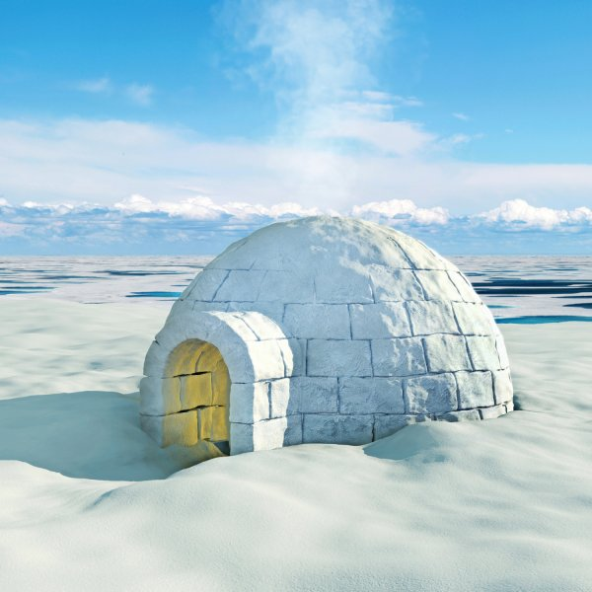
igloo
_gloo

Slide 4
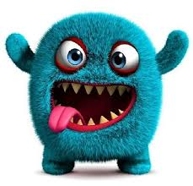
monster
_onster

Slide 5
And last…

Slide 6
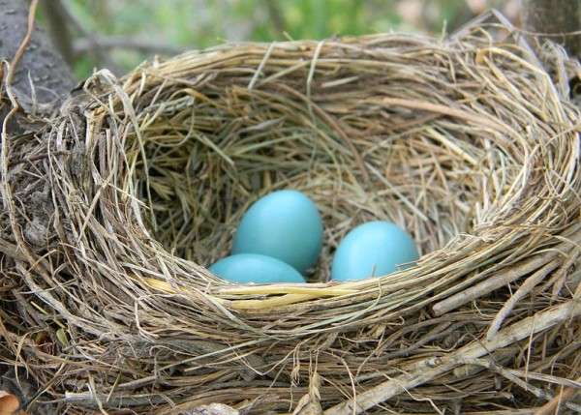
_est
nest

