Slide 1
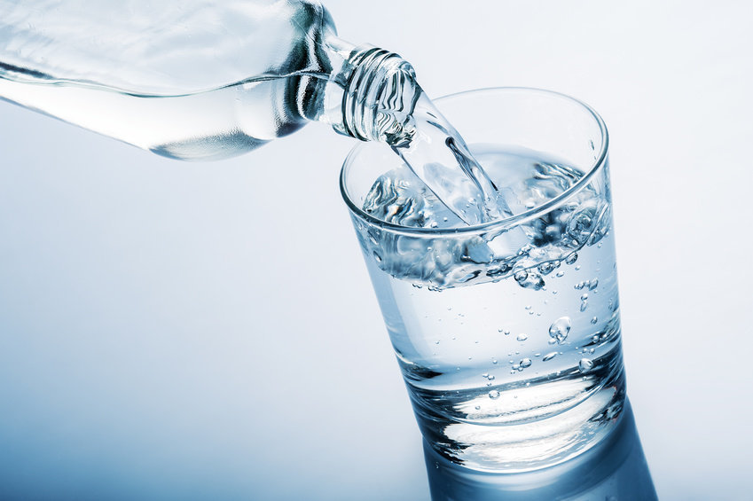
water
_ater

Slide 2
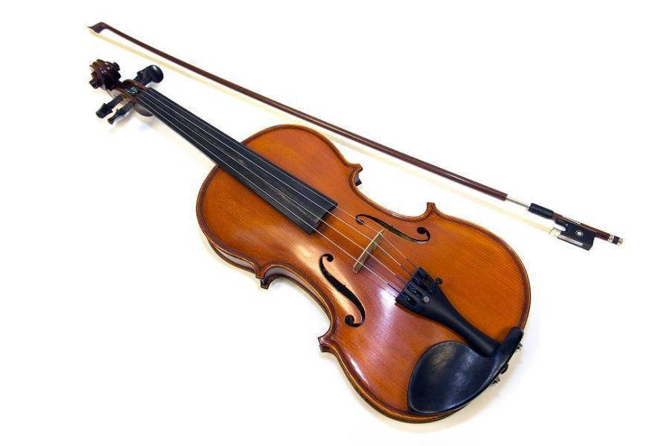
violin
_iolin

Slide 3
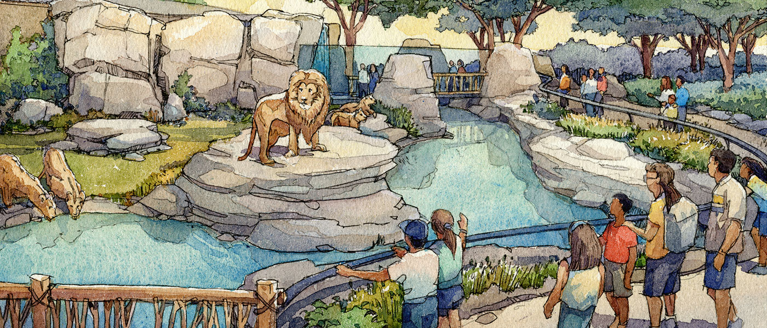
zoo
_oo

Slide 4
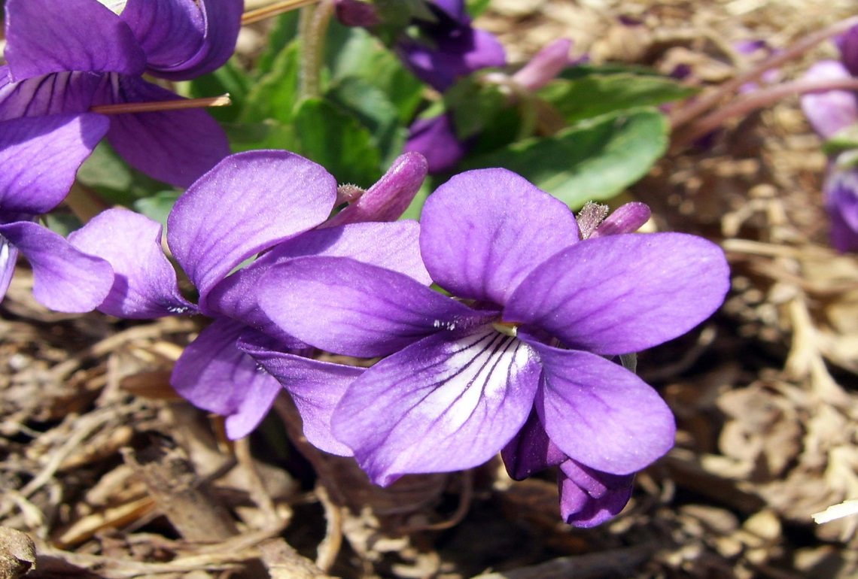
violet
_iolet

Slide 5
And last…

Slide 6
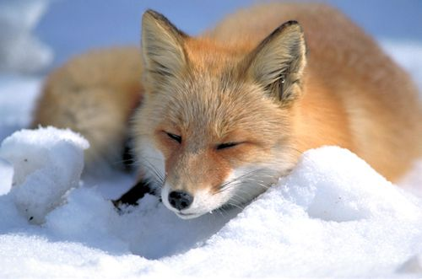
fox
Fo_

