Slide 1
間接DICE

Slide 2
How to play! 遊び方

Slide 3
Tell me when your birthday is.
①
生徒

Slide 4
Ian
Tell me when your birthday is.
Tell me when your birthday is.

Slide 5
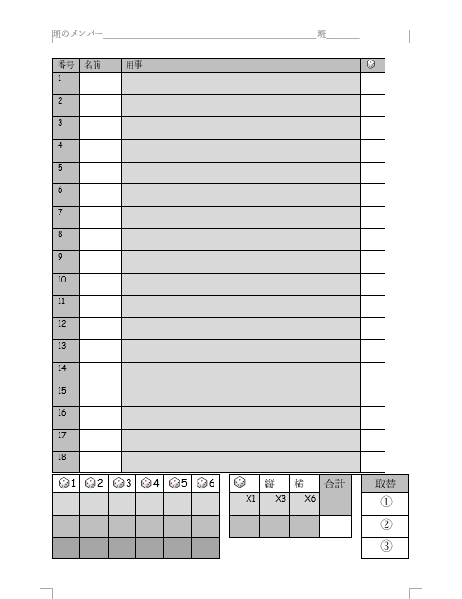
My birthday is January 7th.
Tell me when your birthday is.
Nice!
①
生徒
先生
Tell me when your birthday is.

Slide 6
⚂
⚄

Slide 7
Ian
Tell me when your birthday is.
5
✓

Slide 8
Tell me when your birthday is.
Show me how to swim.
1
2
3
4

Slide 9
スコアの計算
✓
✓
8
1
✓
✓
✓
✓
1
1
✓
8
3
6
1
17
✓

Slide 10
「ウワー！できなーい！」の時
Show me how to swim.
???
✘
✘
✘

Slide 11
Questions?

Slide 12
Tell me – 教えて Show me – 見せて Write – 書いて Draw – 絵をかいて Ask me – 聞いて

