Slide 1
MONA LISA CODE
Find the secret words hidden in the Mona Lisa! when if that

Slide 2
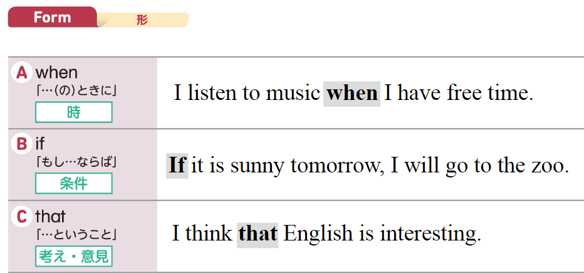

Slide 3
2, 1, 7
A 1 N 14
B 2 O 15
C 3 P 16
D 4 Q 17
E 5 R 18
F 6 S 19
G 7 T 20
H 8 U 21
I 9 V 22
J 10 W 23
K 11 X 24
L 12 Y 25
M 13 Z 26
BAG

Slide 4
I was very happy _ _ _ _ I got this bag.
when if that

Slide 5
I was very happy when I got this bag.

Slide 6
26, 15, 15
A 1 N 14
B 2 O 15
C 3 P 16
D 4 Q 17
E 5 R 18
F 6 S 19
G 7 T 20
H 8 U 21
I 9 V 22
J 10 W 23
K 11 X 24
L 12 Y 25
M 13 Z 26
ZOO

Slide 7
I will go to the zoo _ _ I’m free tomorrow.
when if that

Slide 8
I will go to the zoo if I’m free tomorrow.

Slide 9
19, 21, 14, 14, 25
A 1 N 14
B 2 O 15
C 3 P 16
D 4 Q 17
E 5 R 18
F 6 S 19
G 7 T 20
H 8 U 21
I 9 V 22
J 10 W 23
K 11 X 24
L 12 Y 25
M 13 Z 26
SUNNY

Slide 10
Kaito hopes _ _ _ _ it will be sunny this weekend.
when if that

Slide 11
Kaito hopes that it will be sunny this weekend.

Slide 12
20, 9, 13, 5
A 1 N 14
B 2 O 15
C 3 P 16
D 4 Q 17
E 5 R 18
F 6 S 19
G 7 T 20
H 8 U 21
I 9 V 22
J 10 W 23
K 11 X 24
L 12 Y 25
M 13 Z 26
TIME

Slide 13
_ _ you have time,
we can go.
when if that

Slide 14
If you have time,
we can go.

Slide 15
13, 21, 19, 9, 3
A 1 N 14
B 2 O 15
C 3 P 16
D 4 Q 17
E 5 R 18
F 6 S 19
G 7 T 20
H 8 U 21
I 9 V 22
J 10 W 23
K 11 X 24
L 12 Y 25
M 13 Z 26
MUSIC

Slide 16
_ _ _ _ I listen to the music, I relax.
when if that

Slide 17
When I listen to the music, I relax.

Slide 18
2, 15, 15, 11
A 1 N 14
B 2 O 15
C 3 P 16
D 4 Q 17
E 5 R 18
F 6 S 19
G 7 T 20
H 8 U 21
I 9 V 22
J 10 W 23
K 11 X 24
L 12 Y 25
M 13 Z 26
BOOK

Slide 19
Wendy thinks _ _ _ _
the book is interesting.
when if that

Slide 20
Wendy thinks that the book is interesting.

Slide 21
6, 1, 13, 15, 21, 19
A 1 N 14
B 2 O 15
C 3 P 16
D 4 Q 17
E 5 R 18
F 6 S 19
G 7 T 20
H 8 U 21
I 9 V 22
J 10 W 23
K 11 X 24
L 12 Y 25
M 13 Z 26
FAMOUS

Slide 22
Asami knows _ _ _ _
the café is famous.
when if that

Slide 23
Asami knows that the cafe is famous.

Slide 24
8, 15, 20
A 1 N 14
B 2 O 15
C 3 P 16
D 4 Q 17
E 5 R 18
F 6 S 19
G 7 T 20
H 8 U 21
I 9 V 22
J 10 W 23
K 11 X 24
L 12 Y 25
M 13 Z 26
HOT

Slide 25
I usually open the window _ _ _ _ it is too hot.
when if that

Slide 26
I usually open the window when it is too hot.

Slide 27
GOOD JOB!

