Slide 1
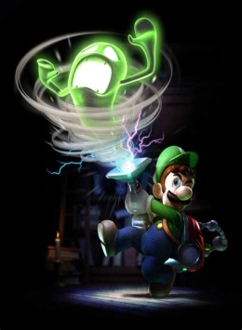
[Paper name]
#1 January, 2024
[Your paper motto here]
Luigi’s Mansion 3
I got Luigi’s Mansion 3 for Christmas from my brother. He bought it and sent it me from the UK. It was actually a present for me and my son and we started playing it together.
Have you played it? So far, it is a lot of fun! We are playing two player, so I am Luigi and Koji is Gooigi! We have played it for around 5 hours, so we haven’t played a lot yet.
Koji is just 6 years old, so a lot of video games can be very difficult for him. But, he surprised me with this game! With a little difficulty at first, he soon started catching ghosts! He has become a little
pro-ghostbuster!
My son and I only play video games at the weekend. So, I am looking forward to playing it again this weekend.
I will try to review it fully when we have finished it.
The button combinations you have to press in this game are quite difficult, so I was a little worried it would be too difficult for my son.
Chris Passed JLPT!
I passed the Japanese Language Proficiency Test (日本語能力試験) level N2!
I am super happy to have passed. I thought that I had done OK after the test and I felt good about my performance.
It was very close though. My reading section wasn’t great, but it was enough to pass that section. I got 97 / 180 points overall.
Over 50% is a pass. N2 is the second highest level. The easiest is N5 and the most difficult is N1.
I don’t want to take the next test (N1) as it is much more difficult. But I will think about it...

Slide 2
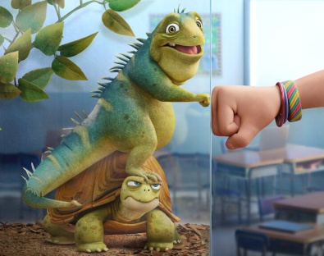
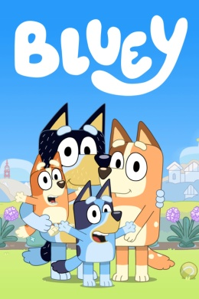
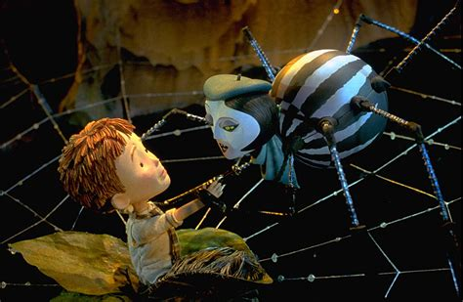
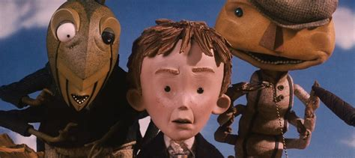
TV/ Movie recommendations
Bluey – Disney+
A family of four Australian dogs living together and having adventures in the real world and in their imaginations. It is a super funny program. Their English accents make me so happy too!
Leo - Netflix
The class pets can talk and have lots to say. A lizard and turtle try to escape their Florida classroom to experience life outside! Very funny film! Good to watch with family!
James and the Giant Peach – Disney+
A movie from the story by Roald Dahl (a very popular writer of children’s stories from the UK). Wondrous adventure with crazy characters but charmingly connected to daily life feelings and worries.
Video game review
Fortune telling (星占い) – Check your birthday!
Lego Marvel Superheroes
I bought
this game for
my son for Christmas and we played through the story quite quickly.
They story is quite interesting with LOTS of characters from the Marvel universe. But, the game gets a bit boring quite quickly and can be quite frustrating in places.
4/10
Aries (March 21 – April 19) Is that a dog? | Taurus (April 20 – May 20) I see many onigiri. | Gemini (May 21 – June 21) You have THE KEY! | Cancer (June 22 – July 22) You will be happy.
Leo (July 23 – August 22) You have all the cheese! | Virgo (August 23 – September 22) I am your brother! | Libra (September 23 – October 23) A ghost will visit. | Scorpius (October 24 – November 21) An insect! Spring?
Sagittarius (November 22 – December 21) A free tea will help. | Capricornus (December 22 – January 19) Zoo fight. | Aquarius (January 20 – February 18) A visit from a fish. | Pisces (February 19 – March 20) Don’t go on the cheetah.

