Slide 1
MONA LISA CODE
Find the secret words hidden in the Mona Lisa! when if that because

Slide 2
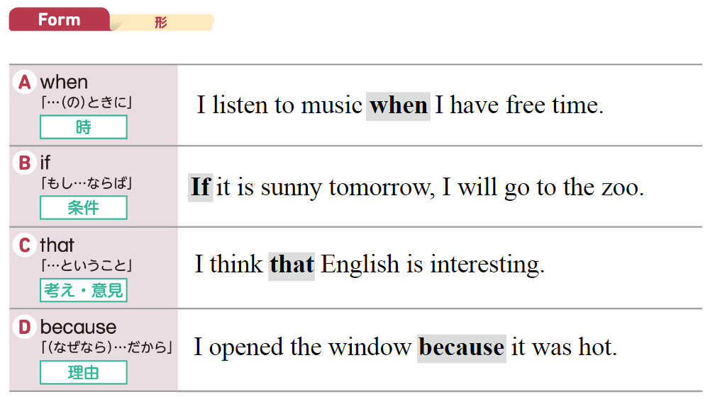

Slide 3
3, 15, 15, 11
A 1 N 14
B 2 O 15
C 3 P 16
D 4 Q 17
E 5 R 18
F 6 S 19
G 7 T 20
H 8 U 21
I 9 V 22
J 10 W 23
K 11 X 24
L 12 Y 25
M 13 Z 26
COOK

Slide 4
I often cook spaghetti
_ _ _ _ _ _ _ it’s easy.
when if
that because

Slide 5
I often cook spaghetti because it’s easy.

Slide 6
4, 18, 9, 22, 5
A 1 N 14
B 2 O 15
C 3 P 16
D 4 Q 17
E 5 R 18
F 6 S 19
G 7 T 20
H 8 U 21
I 9 V 22
J 10 W 23
K 11 X 24
L 12 Y 25
M 13 Z 26
DRIVE

Slide 7
You can drive _ _ you are 18 years old.
when if
that because

Slide 8
You can drive if you are 18 years old.

Slide 9
18, 1, 9, 14, 25
A 1 N 14
B 2 O 15
C 3 P 16
D 4 Q 17
E 5 R 18
F 6 S 19
G 7 T 20
H 8 U 21
I 9 V 22
J 10 W 23
K 11 X 24
L 12 Y 25
M 13 Z 26
RAINY

Slide 10
Ms. Wendy knows _ _ _ _
it will be rainy tomorrow.
when if
that because

Slide 11
Ms. Wendy knows that it will be rainy tomorrow.

Slide 12
6, 9, 19, 8
A 1 N 14
B 2 O 15
C 3 P 16
D 4 Q 17
E 5 R 18
F 6 S 19
G 7 T 20
H 8 U 21
I 9 V 22
J 10 W 23
K 11 X 24
L 12 Y 25
M 13 Z 26
FISH

Slide 13
I don’t eat sushi _ _ _ _ _ _ _ I don’t like raw fish.
when if
that because

Slide 14
I don’t eat sushi because I don’t like raw fish.

Slide 15
19, 23, 5, 5, 20
A 1 N 14
B 2 O 15
C 3 P 16
D 4 Q 17
E 5 R 18
F 6 S 19
G 7 T 20
H 8 U 21
I 9 V 22
J 10 W 23
K 11 X 24
L 12 Y 25
M 13 Z 26
SWEET

Slide 16
She likes chocolate _ _ _ _ _ _ _ it’s sweet.
when if
that because

Slide 17
She likes chocolate because it’s sweet.

Slide 18
3, 15, 12, 4
A 1 N 14
B 2 O 15
C 3 P 16
D 4 Q 17
E 5 R 18
F 6 S 19
G 7 T 20
H 8 U 21
I 9 V 22
J 10 W 23
K 11 X 24
L 12 Y 25
M 13 Z 26
COLD

Slide 19
I drink hot coffee _ _ _ _ it is cold.
when if
that because

Slide 20
I drink hot coffee when it is cold.

Slide 21
8, 15, 20
A 1 N 14
B 2 O 15
C 3 P 16
D 4 Q 17
E 5 R 18
F 6 S 19
G 7 T 20
H 8 U 21
I 9 V 22
J 10 W 23
K 11 X 24
L 12 Y 25
M 13 Z 26
HOT

Slide 22
I usually open the window _ _ _ _ it is too hot.
when if
that because

Slide 23
I usually open the window when it is too hot.

Slide 24
GOOD JOB!

