Slide 1
NUMBER
NAME
Where do you want to go?

Slide 2
NUMBER

Slide 3
NUMBER

Slide 4
NUMBER

Slide 5
NUMBER

Slide 6
NUMBER

Slide 7
NUMBER

Slide 8
40
ROBERT
Where do you want to go?

Slide 9
40

Slide 10
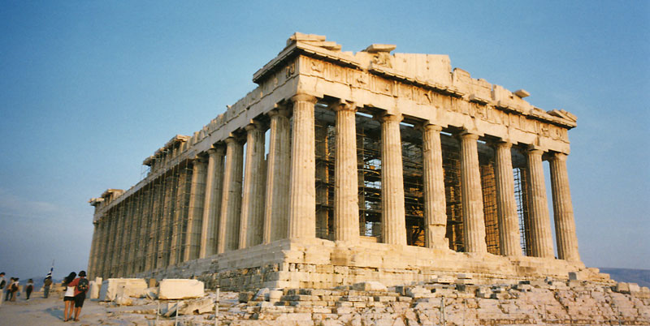
40

Slide 11
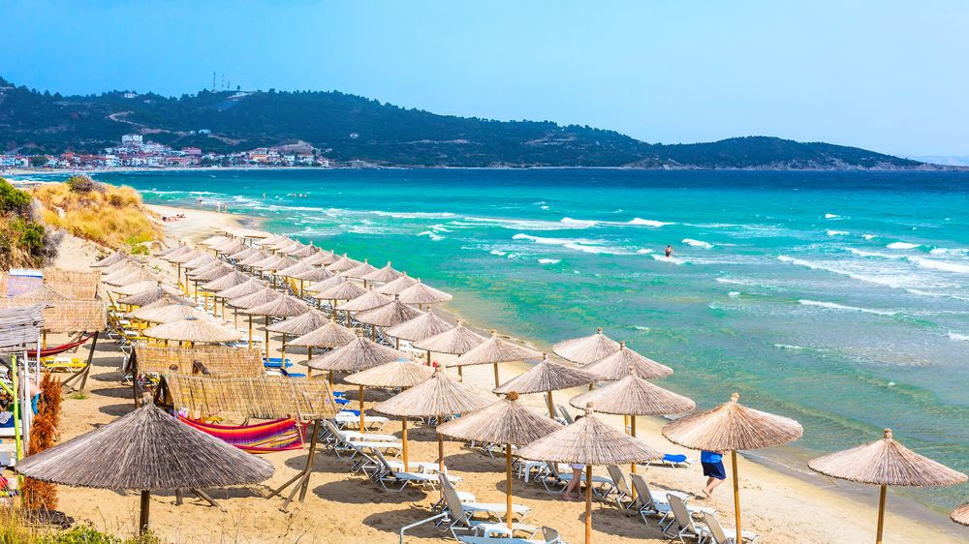
40

Slide 12
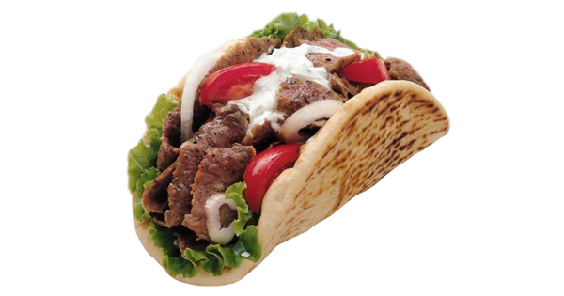
40

Slide 13
40

