Slide 1
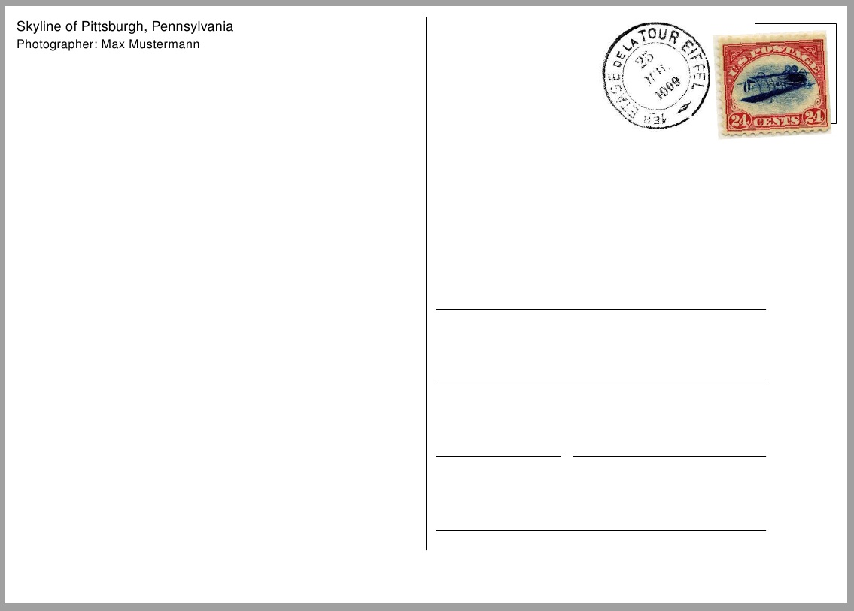
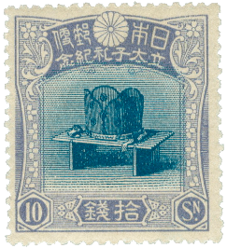
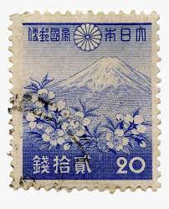
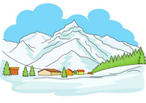
Writing a postcard
February 4th, 2022
Dear Mom and Dad,
How are you? I travelled across Japan recently. Today I saw Kiyomizu-dera and Kinkaku-ji! I am going to climb up Fushimi Inari-taisha tomorrow! It is very cold today. I am inside a ryokan, a traditional Japanese inn. It is snowed a little outside. Kyoto is a very beautiful city. I hope to hear back from you.
See you soon.
Love,
Nathan
123 Canada Road
Mr. and Mrs.
Toronto, Canada
M3R 3X2
___________________________________________________________________________________________________________________________________________________________________________________________________________________________________________________________________________________________________________

