Slide 1
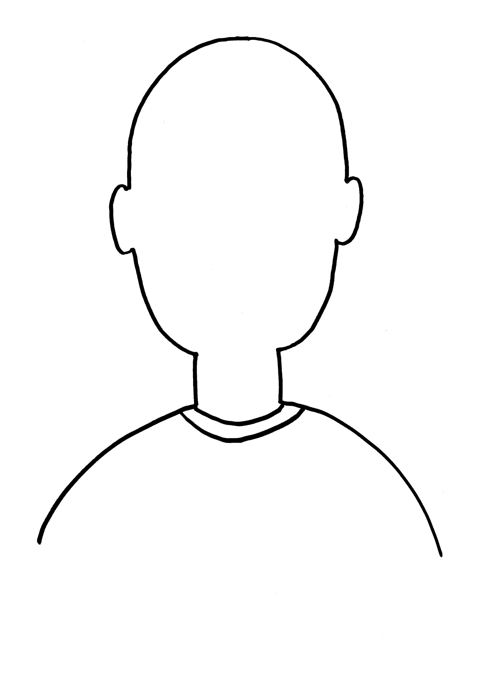
Class:____ No: ____ Name:
JANE
GREG
Vinny
GREG
JANE
Vinny
Class:____ No: ____ Name:

