Slide 1
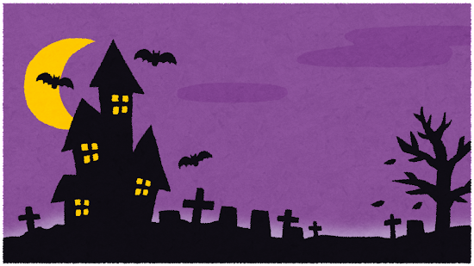
Halloween Comp!

Slide 2
The Deets
Your composition should include:
The use of two conjunctions, such as “and, because, but, or” and so on (and、because、but、or」など、接続詞を2つ使う。)
35-45 Words at least. (少なくとも35-45語)
Atleast 4-5 sentences long. (少なくとも4-5文の長さ)
Should be grammatically correct. (文法的に正しいことはずです)

Slide 3
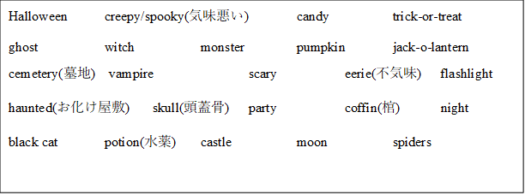
The Words We usin!!

Slide 4
My example ☺
On a spooky Halloween night, many kids were wearing costumes to trick-or-treat. Some kids dressed like monsters or scary clowns. However, under a big full moon, there was a pumpkin carved like a skull. It exploded.

Slide 5
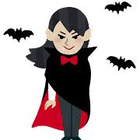
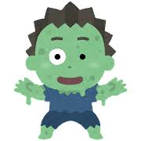
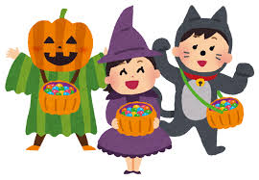
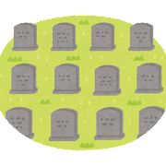
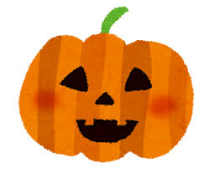
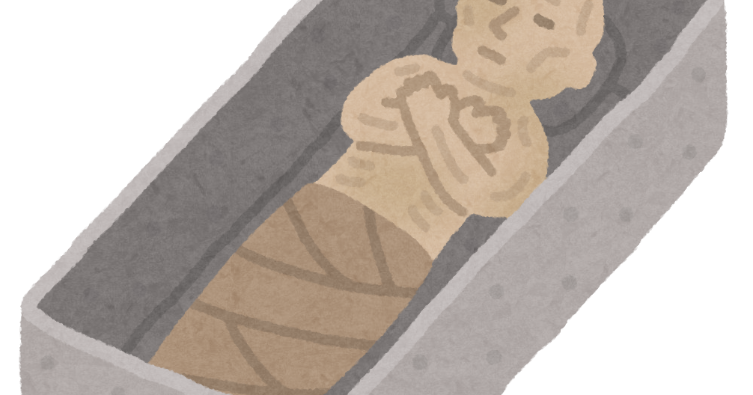
Lil word pics
Ghost
Vampire
Monster
Trick-or-treat
Skull
Cemetery
Jack-o-lantern
Coffin

