Slide 1
Can you read this to me?

Slide 2
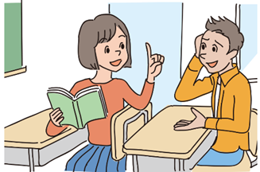
Can I borrow this book?

Slide 3
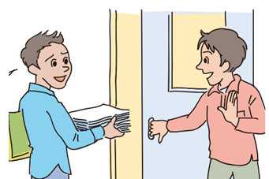
Can you open the door for me?

Slide 4
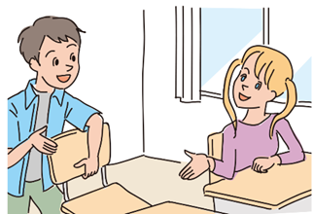
Can I use this chair?

Slide 5
Can you open the window?

Slide 6
Can I watch TV?

