Slide 1
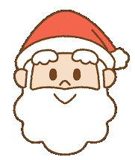
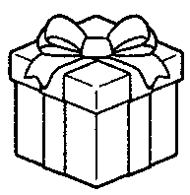
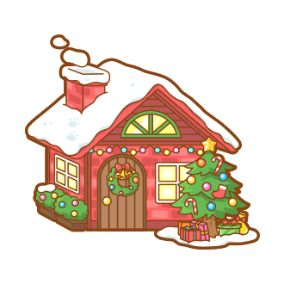
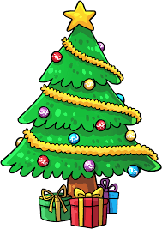
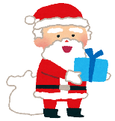
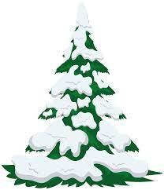
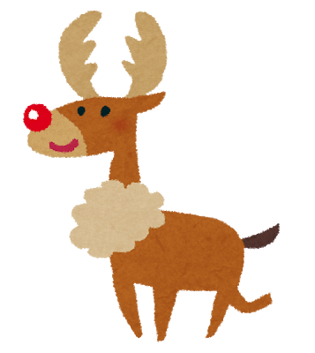
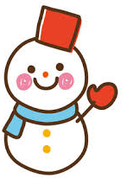
CARD
CARD
What do
you want
for
Christmas?
GET
GO
Can you make
a snowman?
CARD
What
Christmas
song
do you like?
GO
Forward
Forward
3
2
GO
GO
LOSE
Back
Back
What will you
do on your
winter
vacation?
GET
GO
CARD
Do you
like winter?
2
2
Back
Can you make
a snowman?
CARD
2
What do
you want
for
Christmas?
LOSE
Do you
have a
Christmas
tree?
What
Christmas
song
do you like?
LOSE
GET
LOSE
CARD
CARD
1st – 3 pts
2nd – 2 pts
3rd – 1 pt
Finish
GET
CARD
Do you
like snow?
Do you use
a kotatsu?
GET
GO
CARD
What do
you want
for
Christmas?
GO
Can you
ski?
Back
GO
Forward
GO BACK
TO START
1
Back
3
What color
are Santa’s
clothes?
3
Are you
happy on
Christmas?
Where will
you go on
Christmas?
GET
GO
CARD
Back
What do
you want
for
Christmas?
GO
3
Back
3
What do
you want
for
Christmas?
CARD
GET
GO
Do you
eat
Christmas
cake?
CARD
Forward
CARD
1
LOSE
GO
GET
START
Forward
GO
CARD
What do you
eat on
Christmas?
GET
Where will you
go on
Christmas?
GO
1
Forward
Back
1
1

Slide 2
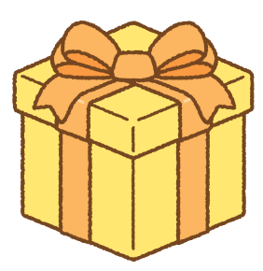
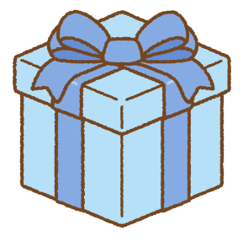
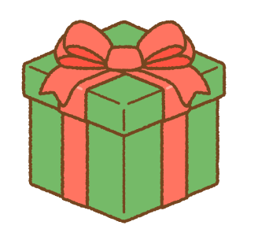

Slide 3
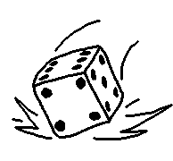
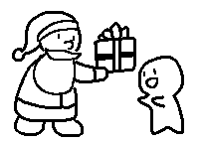
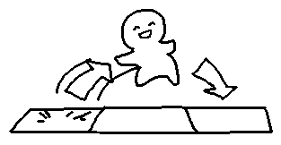
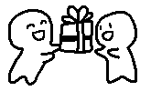
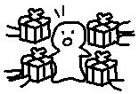
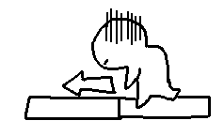
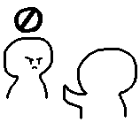
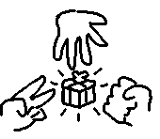
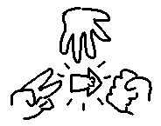
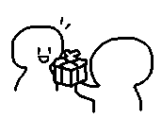
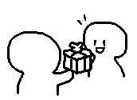
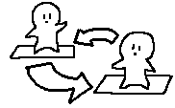
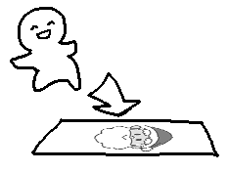
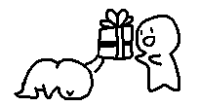
One more turn! You can roll again. | One more turn! You can roll again. | Go forward 2! | Go forward 2! | Get a present! | Get a present! | Choose 1 person. They give you a present!
Choose 1 person. They give you a present! | EVERYONE gives me a present! | Go back 1. | Go back 3. | Choose 1 person. They go back 2! | Choose 1 person. They go back 1! | The person on my left skips their turn!
The person on my right skips their turn! | EVERYONE plays Janken! Winner gets 1 present! | EVERYONE plays Janken! Winner goes forward 3! | I give the person on my left 1 present. | I give the person on my right 1 present. | Choose 1 person. Switch places with them! | Choose 1 person. Switch places with them!
Choose 1 person. Play Janken! Loser gives Winner 1 present! | Choose 1 person. Play Janken! Loser gives Winner 1 present! | Move to the next space! | Move to the next space! | Move to the next space! | One more turn! You can roll again. | Get a present –OR- Chance card!

Slide 4
Chance | Chance | Chance | Chance | Chance | Chance | Chance
Chance | Chance | Chance | Chance | Chance | Chance | Chance
Chance | Chance | Chance | Chance | Chance | Chance | Chance
Chance | Chance | Chance | Chance | Chance | Chance | Chance

