Slide 1
I am watching TV now.
Let’s learn some new grammar!! ☺

Slide 2
現在進行形
Let’s review!
Change this sentence to English!
毎日テレビを見ます。
I watch TV everyday.

Slide 3
現在進行形
Now let’s think!
What are you doing right now?

Slide 4
現在進行形
Right now = 今
Right now → ~ing

Slide 5
現在進行形
I am teaching English
You are studying English
She is watching me
He is not teaching Science
人＋be動詞＋動詞のing形
~をしている

Slide 6
Let’s make a sentence!
人＋be動詞＋動詞のing形
What is she doing?
She is reading a book

Slide 7
Let’s make a sentence!
人＋be動詞＋動詞のing形
What are they doing?
They are swimming

Slide 8
Let’s try some questions!
First, let’s review!
Are you…?
Yes, I am/No, I’m not
Is he…?
Yes, he is / No, he isn’t

Slide 9
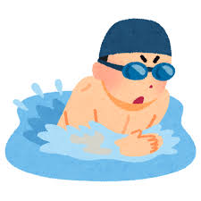
Let’s try some questions!
Is he reading a book?
No, he isn’t
Are you studying English?
Yes, I am/Yes, we are.

Slide 10
Great job!! ☺

